Slide 1

Coping with complexity: building a knowledge graph for UK Parliament
ISKO UK Meetup 2021

Slide 2
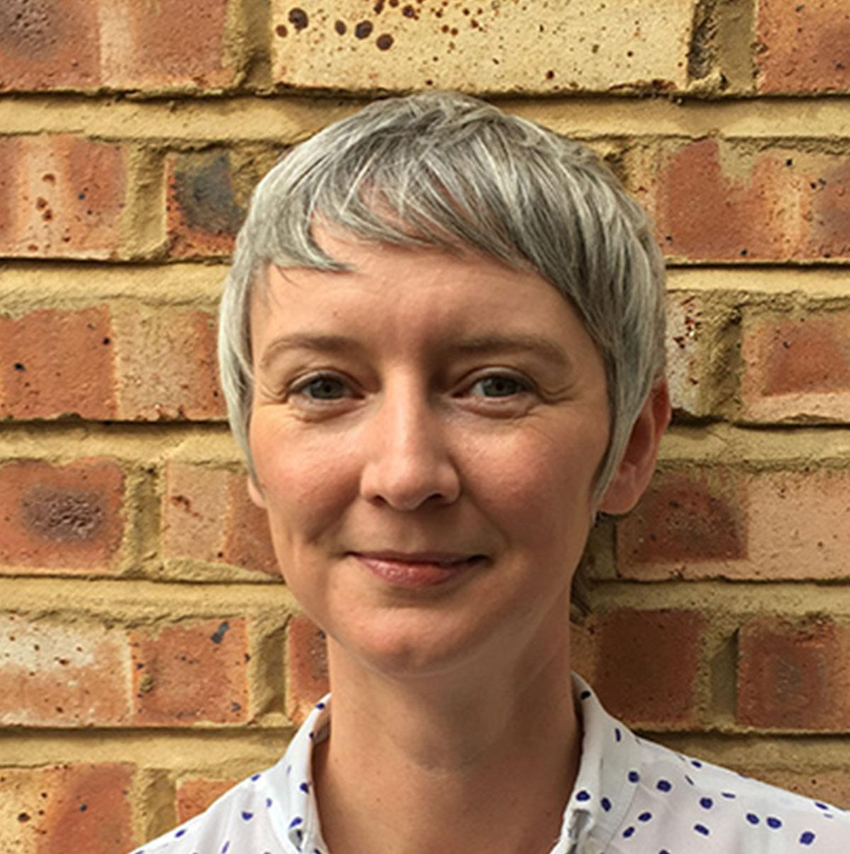
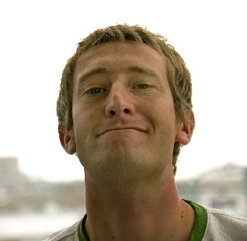
Introductions
Anya Somerville
Michael Smethurst
Head of Indexing and Data Management, UK Parliament
Data Architect
UK Parliament
Notes:
Hello
I’m Anya, a librarian in the House of Commons Library
I’m here with my colleague, Michael, a data architect in the Parliamentary Digital Service
And a big fan of librarians

Slide 3
Tonight’s talk
What Parliament is
What problems we are trying to solve
How we are going about it
What we’ve made
Notes:
We’re going to be talking about what Parliament is
And what it isn’t
How Parliament’s structured
What that means for software
What software means for information management
On the nature of organisational complexity
And what Domain Driven Design can do to help out
All in the context of managing information to support secondary legislation

Slide 4
What is Parliament?
Notes:
So first up, what is Parliament

Slide 5
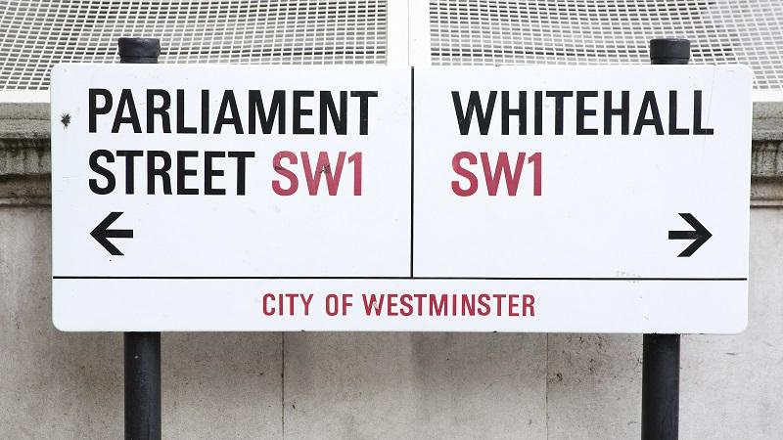
Notes:
To explain Parliament I need to explain what it isn’t
Parliament is not Government
We have been asked many times whether we work for the Civil Service
And it’s been assumed many times we are somehow associated with the Government Digital Service
Neither of these things are true
The only thing we really share with Civil Servants are the pubs around Westminster
And even then, we tend to scorn their queuing technique

Slide 6
What is Government?
Is accountable to Parliament
Proposes new laws to Parliament
Runs public departments
Notes:
So what is Government?
They are accountable to Parliament
And through Parliament to the public
They propose new laws to Parliament
And they run government departments from DEFRA to the Home Office

Slide 7
What is Parliament?
Holds Government to account
Allows input from citizens
Debates issues to influence decision making
Notes:
Parliament on the other hand is mainly there to hold Government to account
It allows inputs from citizens
And it debates current issues in order to influence both Government and wider society

Slide 8
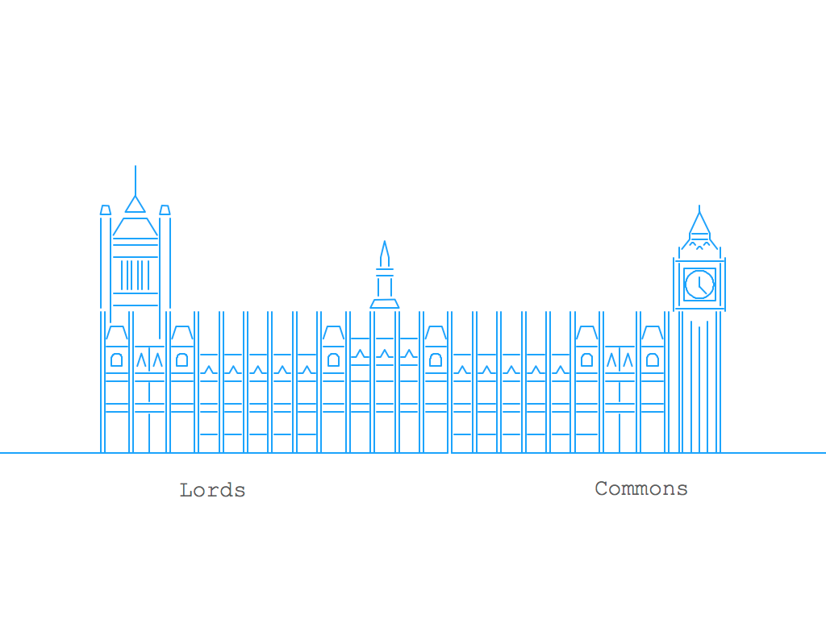
Notes:
The second thing to know about Parliament is it doesn’t really exist
There is no single sense of Parliament
There is the House of Commons - the democratically elected lower chamber
There is the House of Lords - the upper chamber of Parliament, with members appointed. In a fashion.
And there is The Crown. Or the Queen in Parliament. As separate from the Queen as a person. The Queen is the Head of State: she opens every session of Parliament and agrees legislation
Over time, the powers of the Crown have diminished. But some matters are still reserved under Royal Prerogative
Matters like declaring war, ratifying treaties and proroguing Parliament for instance
Which some of you may remember being called into play in the Brexit debates
So Parliament is not a single institution
A more realistic drawing might look like...

Slide 9


Notes:
This
At least if we put the Queen to one side for a moment
The Commons and the Lords are independent organisations
There is no one person in charge of Parliament
There is no common ruleset, though the way in which the two Houses operate may be interlinked
So if there’s no such thing as Parliament, what’s the big building about?
Think of it as a conference centre hosting two separate but interlinked conferences and you wouldn’t be far wrong
As some of you may know, the word Parliament is derived from the old French parlement, which means discussion or discourse

Slide 10
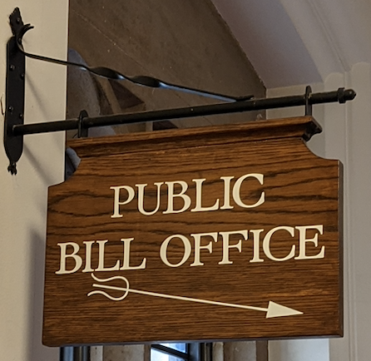
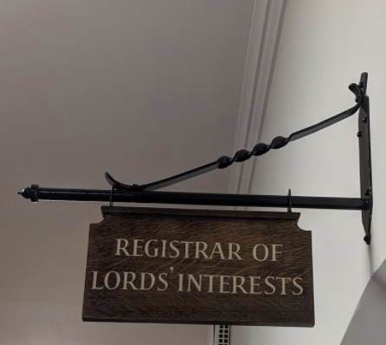
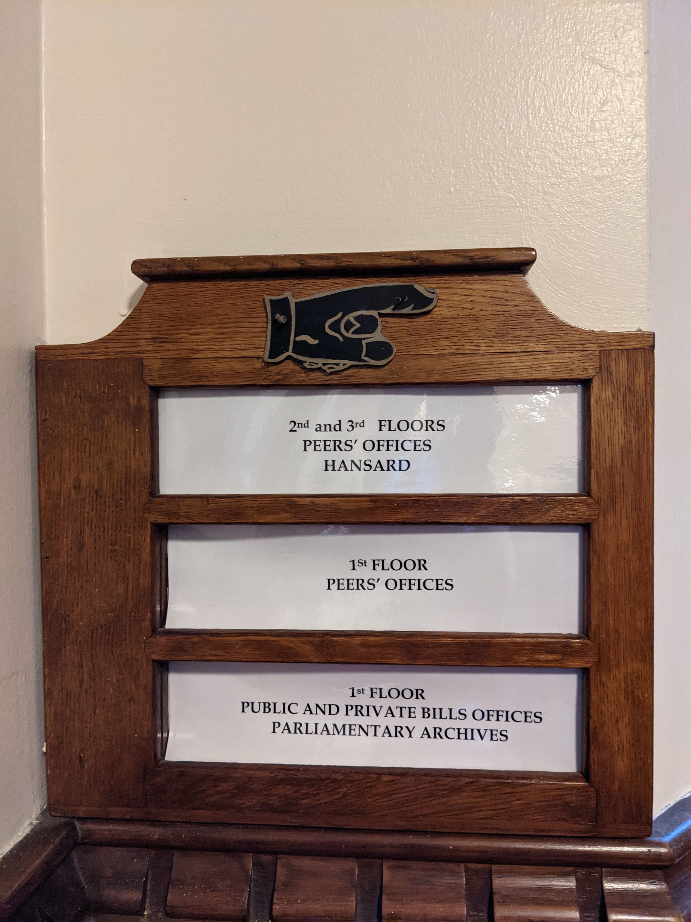
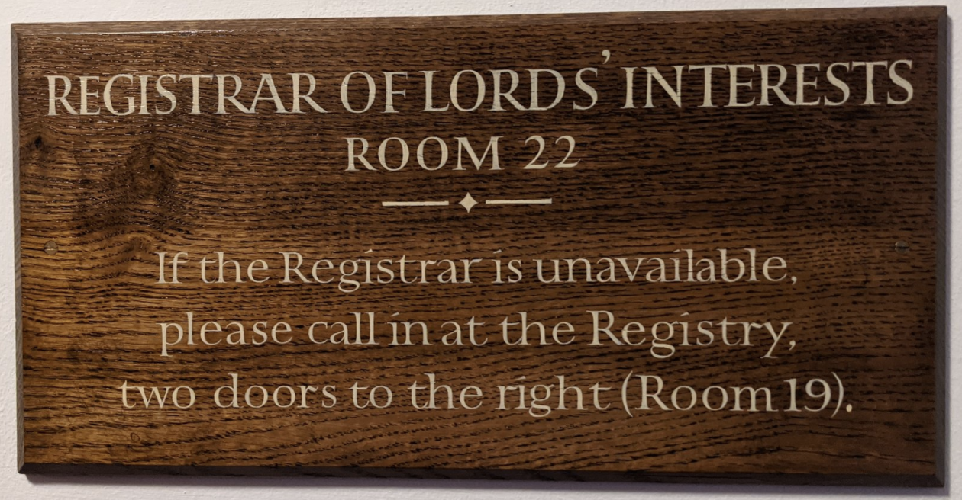
Notes:
The third and final thing you need to know is how complicated the internal structures are
The are Table Offices, Legislation Offices, Journal Offices, Vote Offices, Committee Offices
And all of this is duplicated across the two Houses
Individual offices are largely autonomous
One person in each House has oversight of all of them
The workflow between offices typically being facilitated by documents being exchanged at the end of some process

Slide 11
The problem
Notes:
So, that is Parliament for beginners
On to one of the problems we’ve been trying to solve

Slide 12
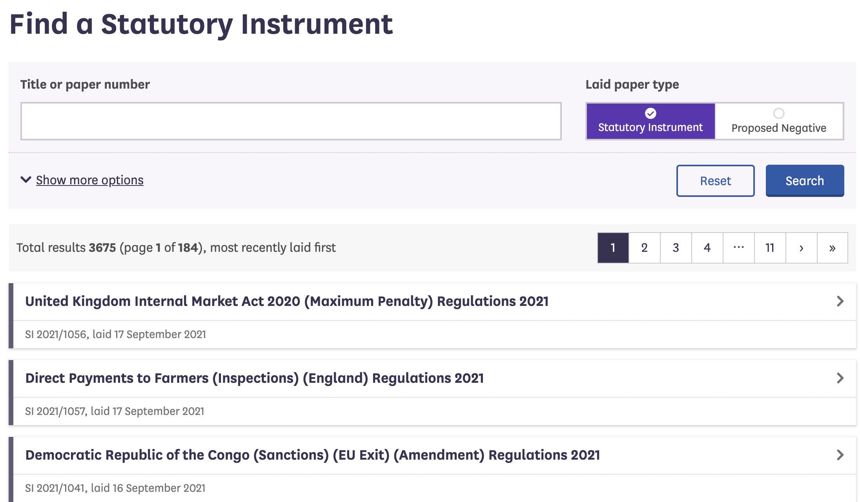
Notes:
In 2018 we were asked to make a publicly available Statutory Instrument tracking service
And we did
This talk is kind of about that
But hopefully some of what we cover will be applicable anywhere and to anything

Slide 13
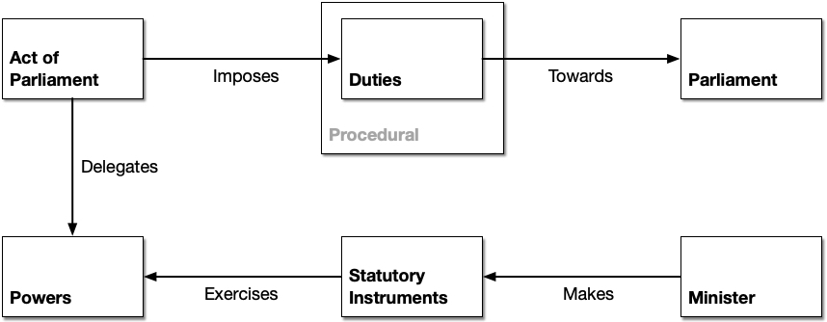
Notes:
For those new to Statutory Instruments
Acts of Parliament delegate certain powers to ministers
Ministers may create secondary legislation under these powers so long as they comply with certain duties toward Parliament
In the UK SIs are the most frequently used type of secondary legislation

Slide 14
First brexit then the pandemic
Notes:
The important thing in terms of our time scales was that much of the legislation required to implement brexit was expected to arrive in the form of statutory instruments
And indeed did
Since then, we’ve all been through the pandemic
Much of the legislation used to deal with that has also been in the form of statutory instruments

Slide 15
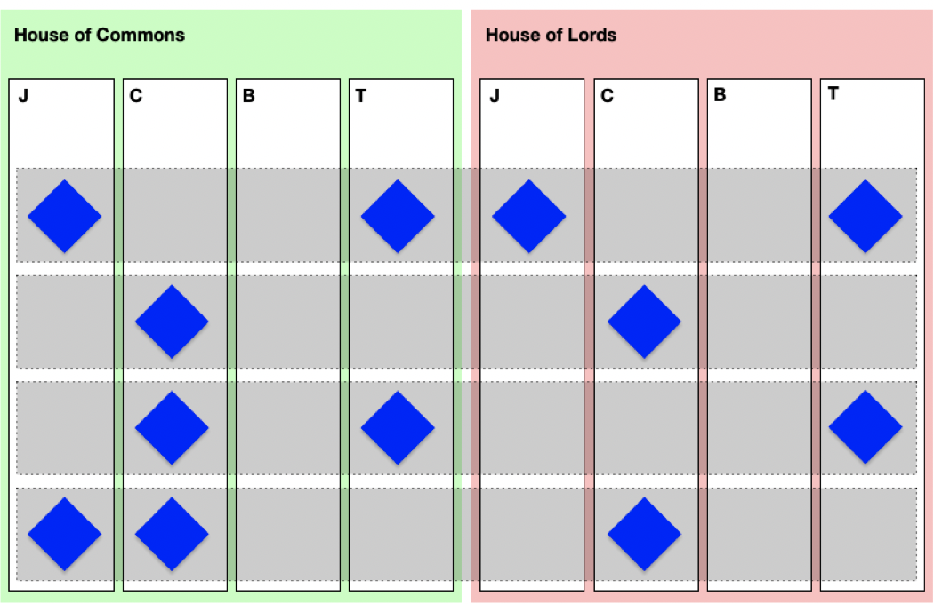
Notes:
Almost all offices in both Houses touch on statutory instrument procedure
Both Journal Offices, both Table Offices and various committees
In order to track an SI one needs to track the activities of assorted committees and offices represented here
You need to know which committees are likely to scrutinise an SI, when those committees tend to meet, when those committees tend to publish reports and where those committees tend to publish reports
And that’s just the committee part
People found it difficult to track the journey of an SI through Parliament
Even Members of Parliament may have struggled

Slide 16
This says nothing to me about my life
Notes:
At this point, you may well be thinking well, this is interesting but it’s unlikely I’ll ever have to model a parliamentary procedure in my day job
Or you may be thinking this really isn’t interesting at all
You may, in fact, be doom scrolling Twitter as I speak
But, whilst the details may be different, we hope most of this talk is applicable to any reasonably sized organisation

Slide 17
The importance of well-managed information
Notes:
So we are information modellers and managers. We think tracking an SI is an information management problem
But information management is often no-one’s job

Slide 18

Website
EASY:
Quite EASY:
Data platform
Fairly EASY:
Data authoring
tools
Quite HARD:
Business applications providing data
HARD:
Changing workflows/ job descriptions
Very HARD:
Union negotiations
IMPOSSIBLE:
THE EVENT HORIZON
Notes:
At this point we turn to our trusty iceberg metaphor
Making websites, visualisations and querying data is relatively easy
Making a data platform and models that are as flexible as Parliament is harder
Managing the information is harder still
Managing the information when It’s not in anyone’s job description starts to get impossible
And you pretty quickly reach the event horizon of the possible
But, the problem is more than just jobs and roles

Slide 19
Your Finance Department controls your information management
Notes:
Information management is only ever as good as the tools available
How those tools are commissioned and paid for influences and constrains the shape of the data they produce

Slide 20
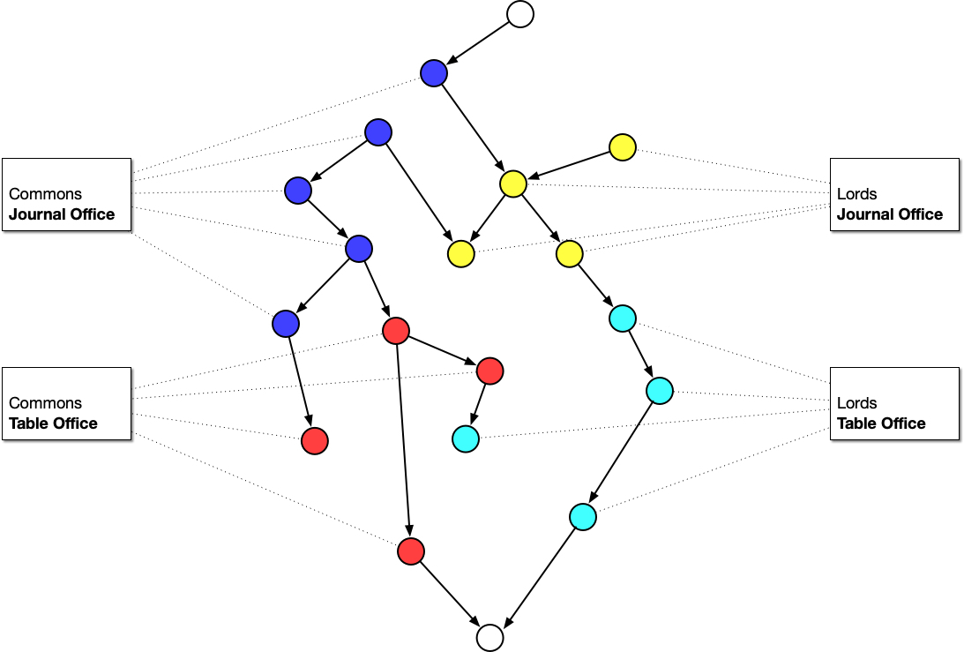
Notes:
Given each office has their own view of the problems they need to solve, we often end up commissioning tools to digitise existing office bound processes and missing out on the bigger picture
This is not peculiar to Parliament
At the BBC, the people managing “talent” – the people you see on air – would commission a system to handle talent
The people responsible for complaints would have their own system to manage that
The broadcast engineers had a system to handle transmission times
The schedulers a system to handle scheduling
And etc
The systems were not designed to interoperate so they could never be any more than the sum of their disjointed parts

Slide 21
Don’t put your organisational structure on the web they said
Notes:
You may well have heard the phrase don’t put your organisational structure on the web
No one being particularly interested in your reporting lines
But with disjointed information commissioned from the perspective of a single office, this is often inescapable

Slide 22
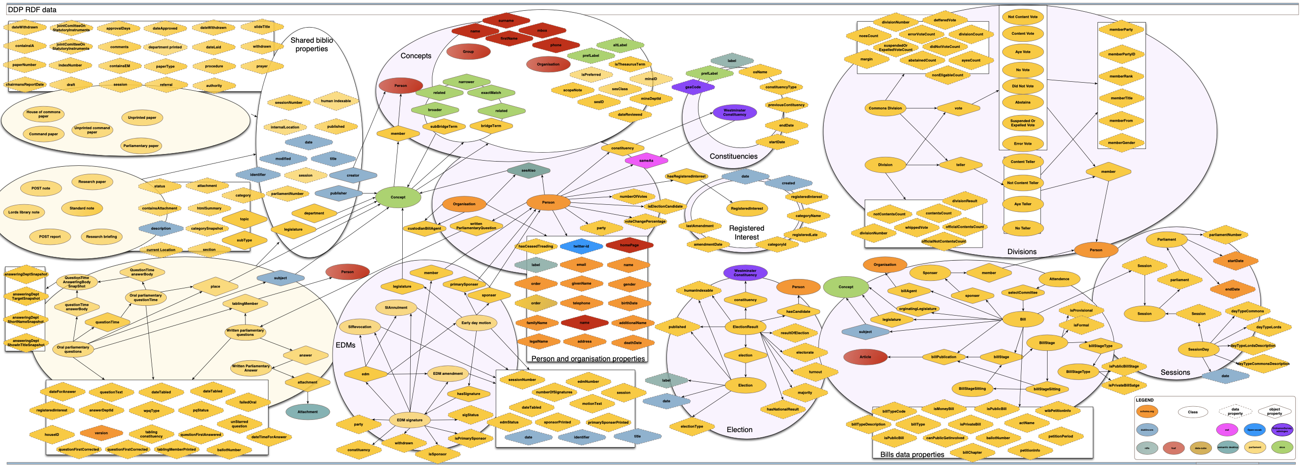
Fragmented data
Notes:
This is a picture of data.parliament reverse engineered from instance data
It is supposedly an open data portal where developers can grab data and build new things
But the problem of disjoined information is hopefully obvious
Each large blob on that diagram is pretty much analogous to an internal system
And each system is pretty much analogous to an office
The blob at the top right represents division data – how Members vote in Parliament
It is connected to our Member records
It is not connected to the things they were dividing on

Slide 23
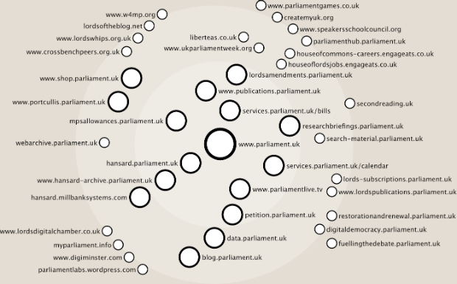
Website for each office or project
Over 50 different domains
Notes:
And this is the result on the website
Upwards of 50 different domains, none of them terribly well interlinked
This is a old picture
Lots of these microsites have now been replaced
But the general point holds true

Slide 24
Parliament is not complicated
Notes:
Having listened to us thus far, you may well be thinking, well this slide doesn’t make much sense
Please bear with us

Slide 25
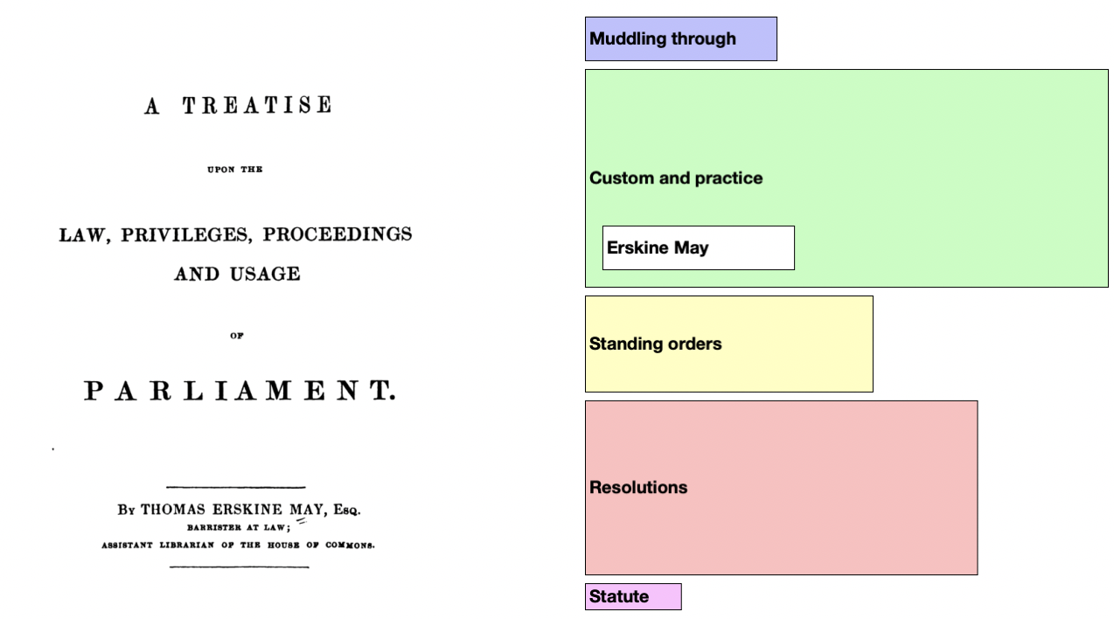
Notes:
Parliamentary procedure is, broadly speaking, the rules and conventions of how parliamentary business gets done
The image on the right, we stole from Paul Evans - a retired Clerk of Committees in the House of Commons
It shows the components that inform procedure
The further down the stack the more immutable
The larger the block the more often it comes into play
In order to map procedure we need to take account of statute, standing orders, speaker rulings and precedence
And we also need to take account of “muddling through” because improvisation is how a lot of things work

Slide 26
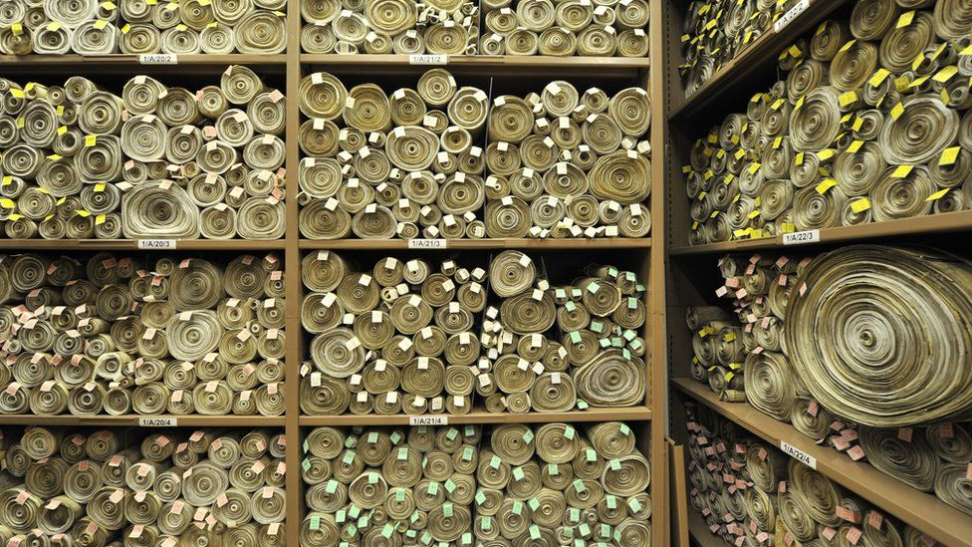
Notes:
Taking those components and working from the bottom up, let’s talk about statute or legislation
This is a picture of a room in Victoria Tower where Acts of Parliament - printed on vellum - are stored
Some of the proceedings of both Houses are set out in legislation
The Statutory Instrument Act 1946 being the obvious one for the purposes of this talk
In reality only a very small subset of procedure is set out in legislation

Slide 27
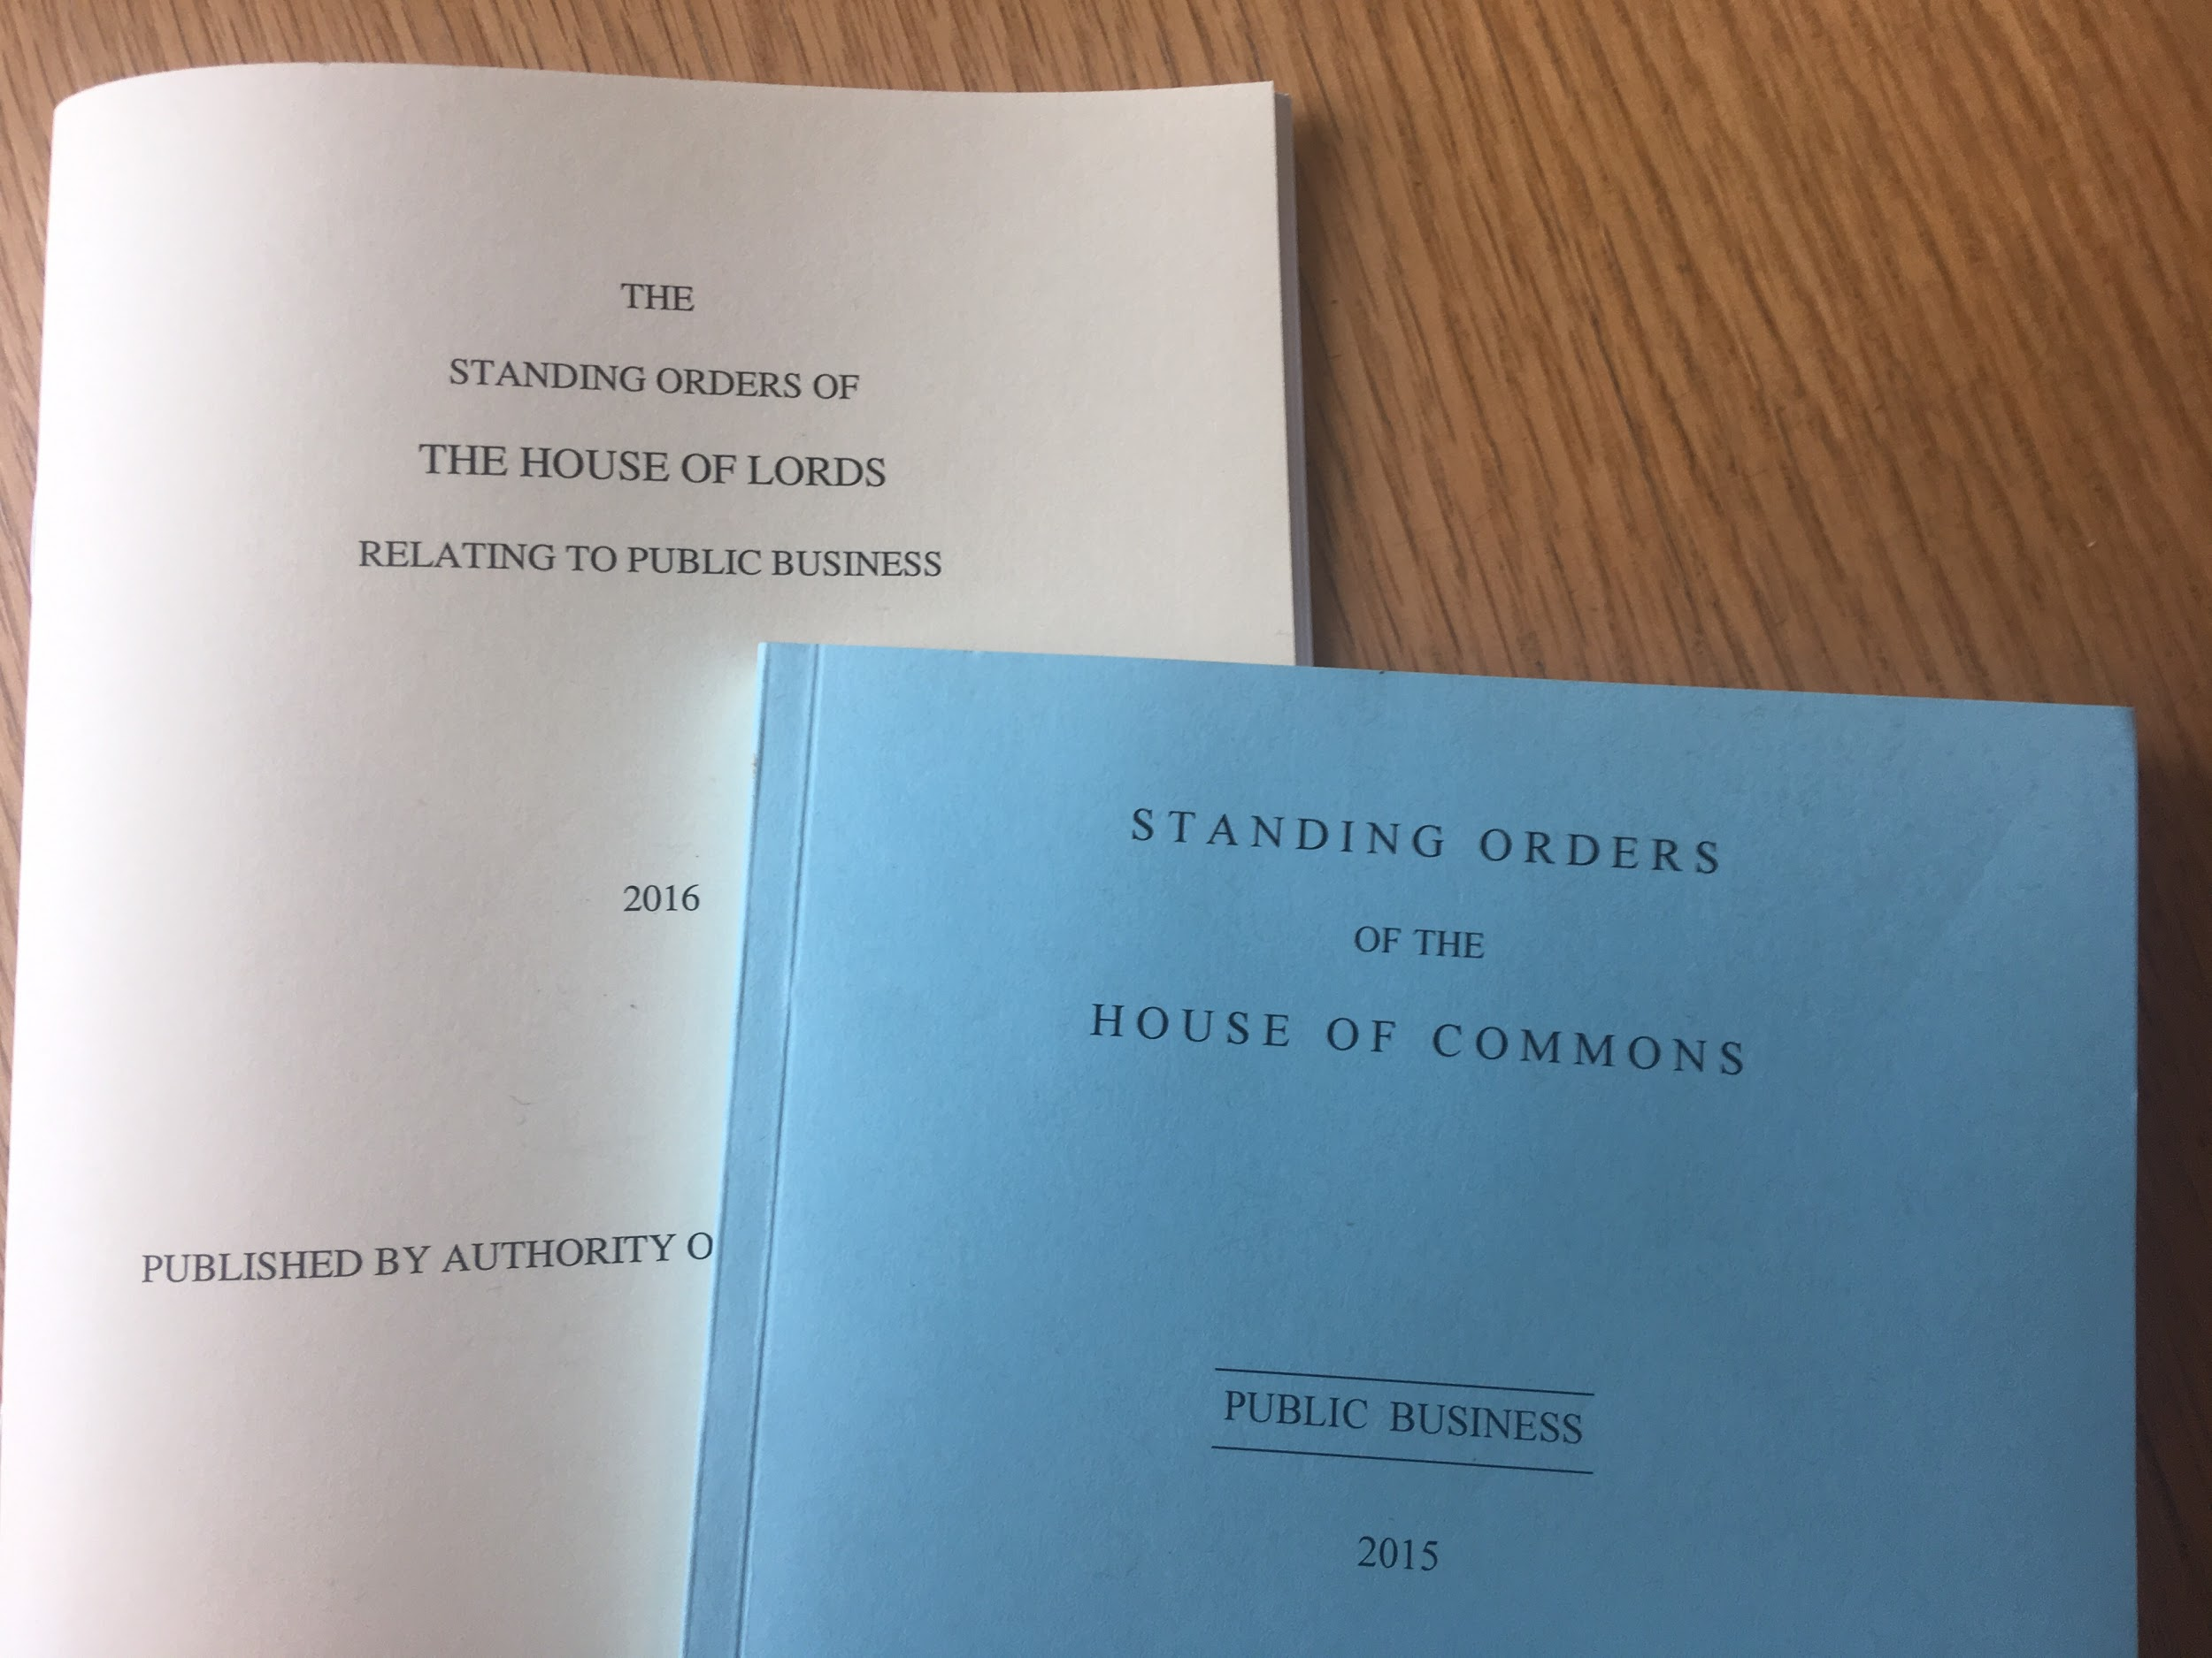
Notes:
Skipping over resolutions of the House, these are the standing orders - the written rules which regulate the proceedings of each House
There are two sets of rules because the two Houses do similar things, but in slightly different ways
And, once again, they don’t cover everything

Slide 28
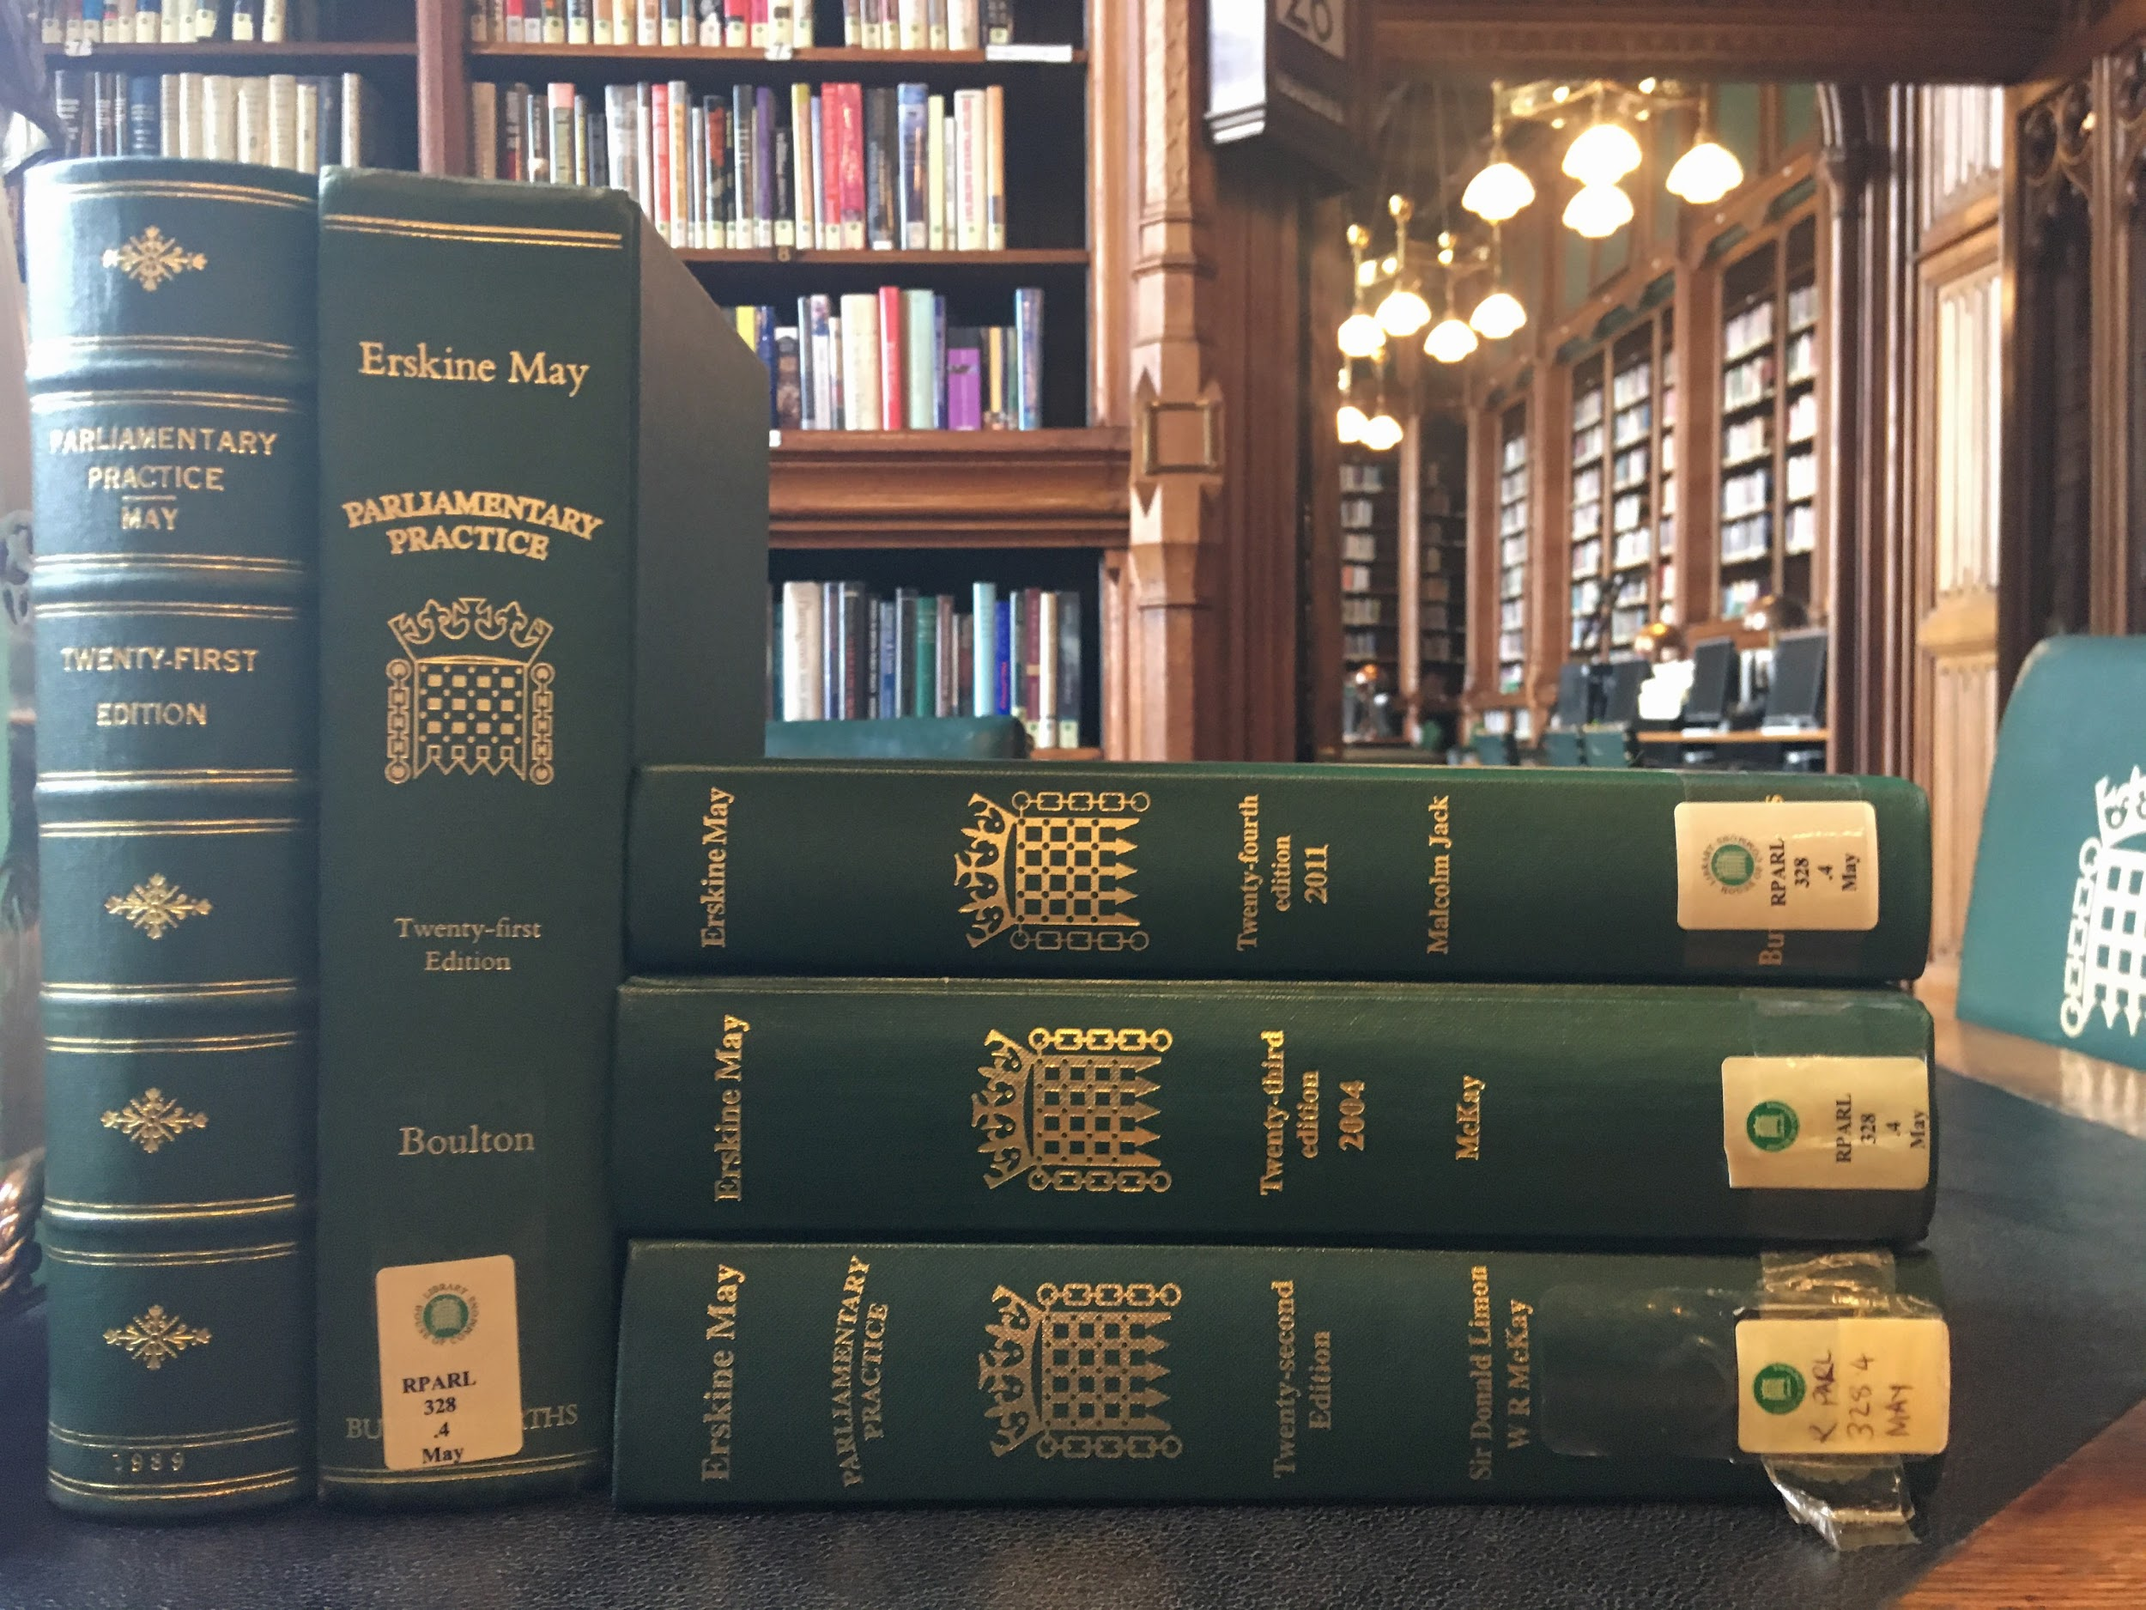
Erskine May
Notes:
On top of the rules, there is precedent, or “custom and practice” - things that are permissible because they've been permitted in the past
Like the rest of our constitution, much of parliamentary procedure has developed over the centuries, and isn’t written down in the Standing Orders
This is Erskine May. Parliament’s Bible. it collects precedent in the form of narrative accounts
So we have a fuzzy rule set: events test the rules, the organisation adapts, new processes emerge
It doesn’t end there though

Slide 29
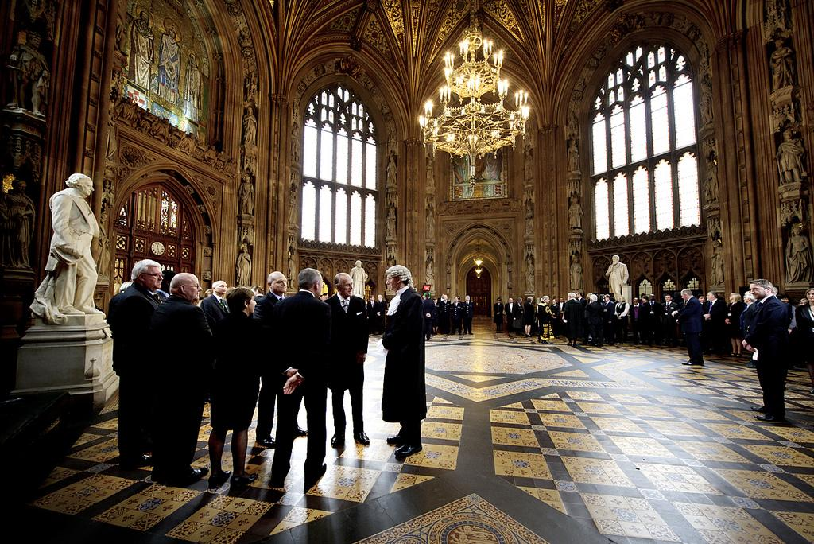
What is Parliament?
Notes:
And on top of rules and precedent there are people
A lot of politics is about people
Some things happen on stage, some things off stage
Even where there are rules, implementation is subject to interpretation
You might remember that some of Speaker Bercow’s interpretation of the rules received quite a lot of attention during the brexit period
Occasionally, there are no rules set out anywhere
We’re currently in the midst of mapping a procedure that is set out in neither legislation nor standing orders and which has never happened before
We would say more, but we can’t
But again, Parliament is not special
Rules + customs and practice + people is almost always true, of any organisation

Slide 30
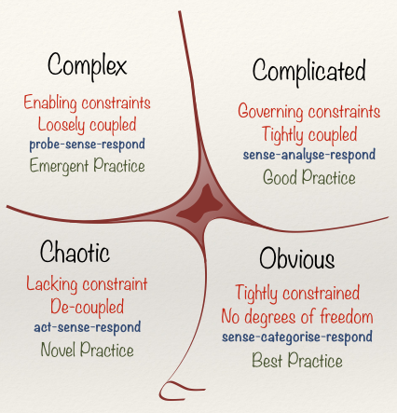
Cynefin
Complex
Complicated
Chaos
Simple
Dave Snowden, Cognitive Edge
Notes:
This is Cynefin – a knowledge organisation framework by Dave Snowden
It’s designed to give organisations some sense of situational awareness
To know which space or spaces they’re operating in and act accordingly
Much software is designed and built on the assumption that Parliament – or any other organisation - operates in a complicated space
And whilst some bits of Parliament are complicated, it is, at heart, a complex adaptive system
Which is why you’ll often hear us banging on about emergent behaviours
Tightly coupling the implementation of software and data models to defined rulesets makes the software and its resulting information brittle and liable to break when underlying rulesets are adapted or reinterpreted
We’re sure people in the audience will be familiar with software insisting that a piece of information is mandatory when that information doesn’t exist
Whilst we may wish to be conservative on output, it is always best to be liberal on input

Slide 31
Finding and binding correct contexts in a complex domain
Notes:
In order to make services that meet needs outside individual offices we need to step back and look for new patterns that don’t stop at office walls
And we need to be aware of both complications and complexity

Slide 32
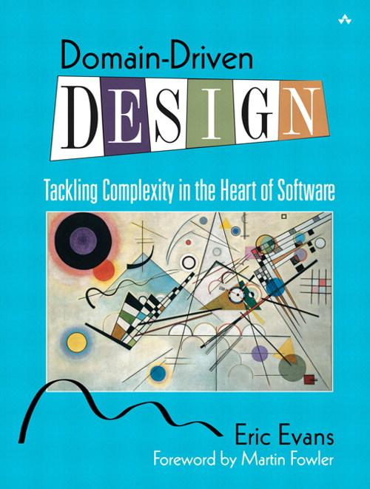
Domain-driven design
Notes:
This our bible
Domain Driven Design by Eric Evans
It has been described as somewhere between profound and self-evident
And we’d recommend reading at least the first three chapters to almost anyone

Slide 33
What is domain modelling?
A creative collaboration
Drawing back at each other
Talking about things in a natural context
Notes:
You may have heard of agile
It’s a response to a complex situation and the need to probe, sense and respond
And Domain Driven Design is a technique emerging from the agile development community
Like agile it emphasises collaboration over contract negotiation

Slide 34
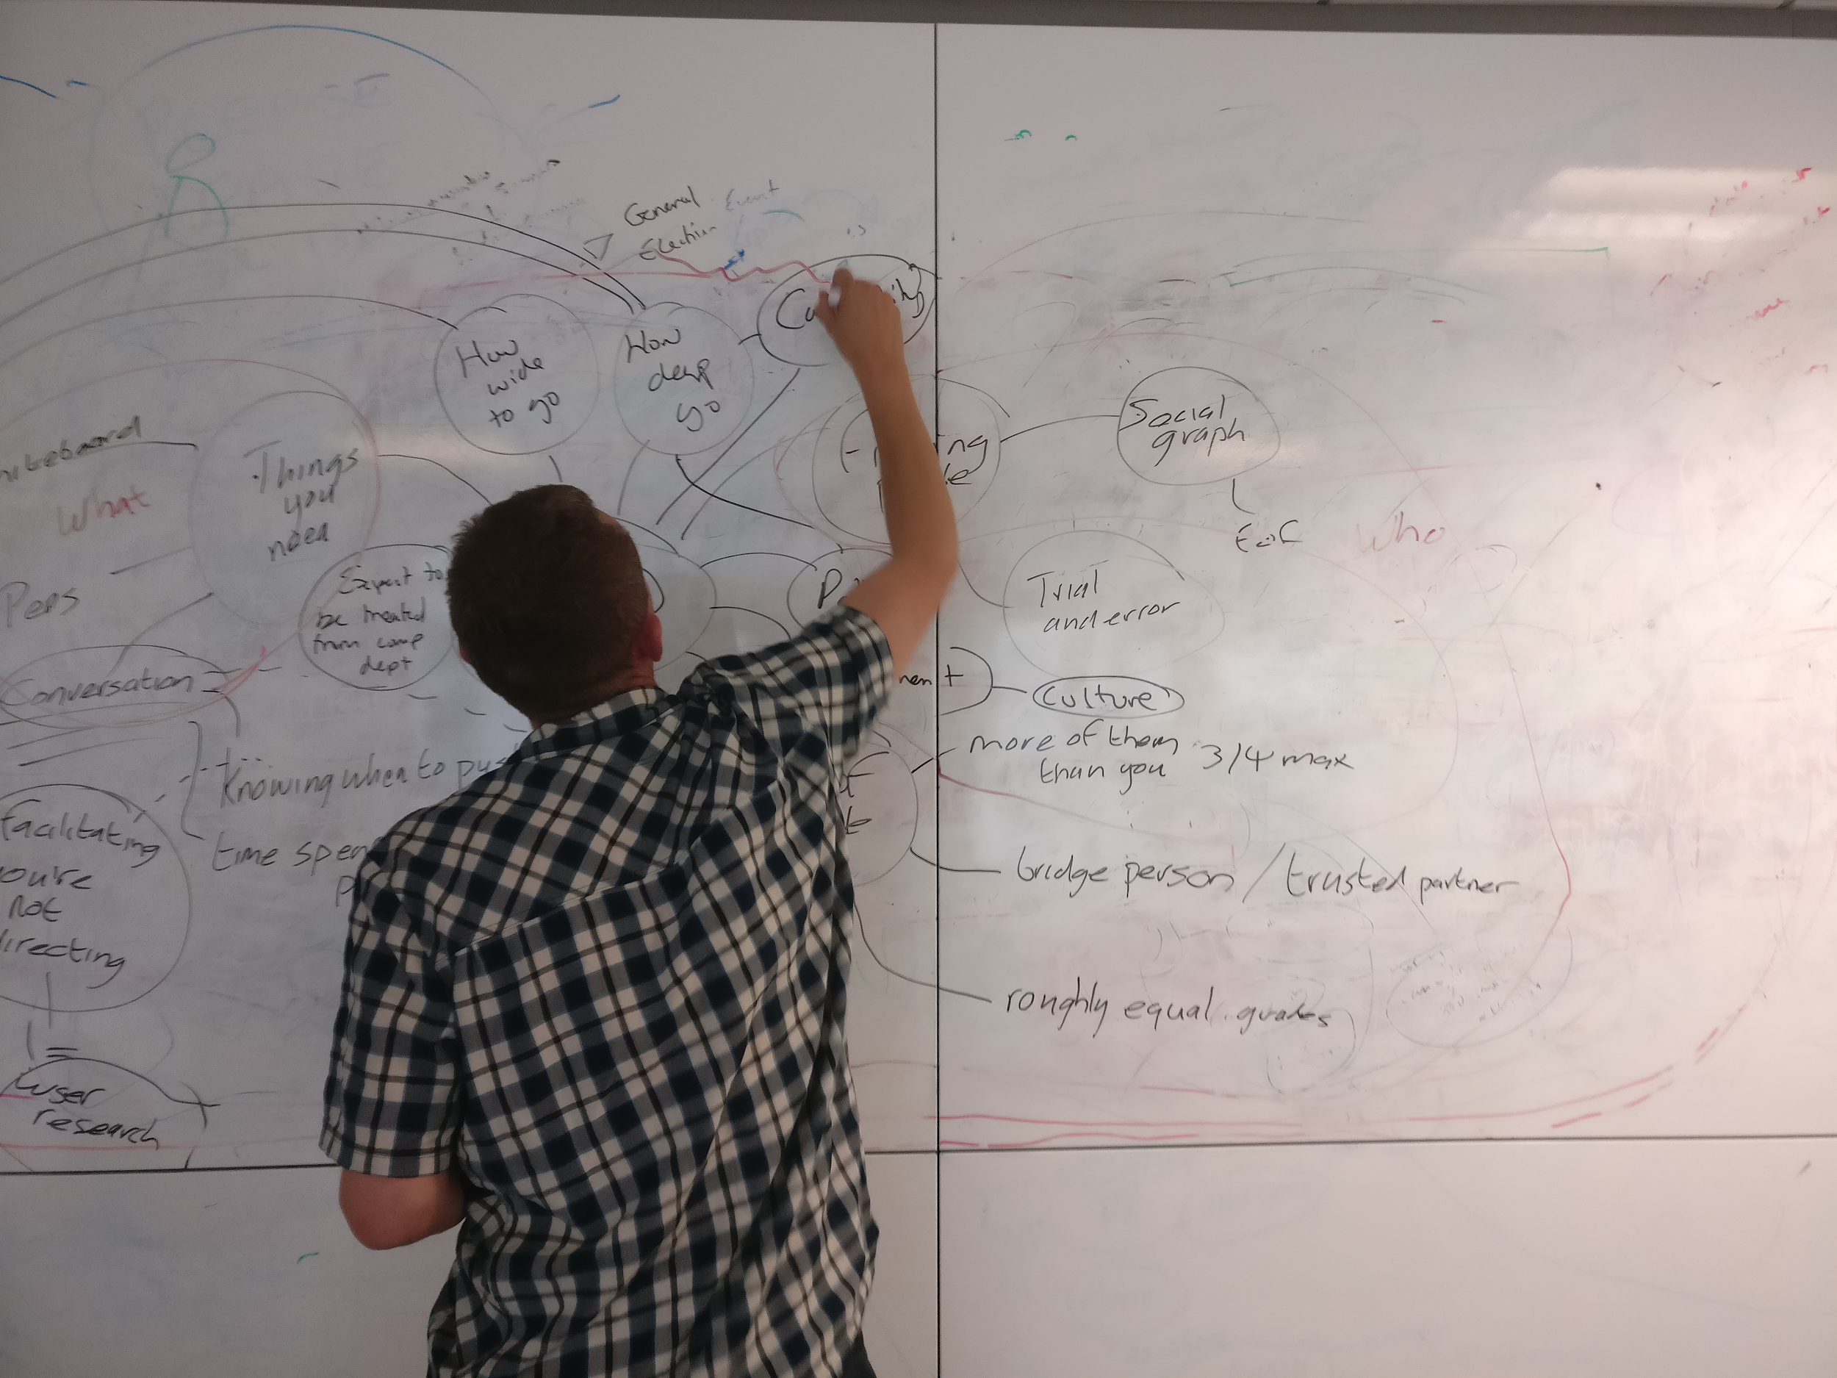
Notes:
Usually the collaboration takes the form of gathering around a whiteboard and lots of listening
Most of the work is probing for definitions, always accepting that the same words may have different definitions in different contexts
Importantly, it’s not about one person speaking and one person drawing
The aim is to draw back at each other
As Eric Evans said, if you give someone a diagram they will agree with you. Get them to draw it and you see the difference
The aim is to explore the domain from as many perspectives as possible

Slide 35
Some tips for domain modelling
Notes:
So, some tips for domain modelling
It’s important to say, we’ve found these work for us
But there are no silver bullets
Your mileage may vary

Slide 36
(0)There is no such thing as metadata think things not strings
Notes:
This is where we’re pleased to be speaking at a virtual event
Where it’s unlikely we’ll be heckled off stage
The slide is incorrect of course
There is such a thing as metadata, it’s just not usually what people mean when they say it
The author of a book is a person – or a corporate author
It’s not a string, however controlled
An artist performing a music track is a person or a group of people
Factory Records was an organisation, not some text in a ”metadata” field
This is possibly the trickiest thing when you’re switching from taxonomies to ontologies
When domain modelling think about things
And thingyness

Slide 37
(1)There are always more unknown unknowns than known unknowns
Notes:
You’ll probably arrive at a domain modelling session with questions in mind
And sometimes conversation will drift away from those questions
Let it drift
Unlike some practitioners of user research, try not to arrive with a script and let the conversation go where it takes you

Slide 38
Facilitating not
directing (from a script)
Congruence – without hiding behind a professional or personal facade.
Unconditional positive regard – demonstrating a willingness to attentively listen without interruption, judgement or giving advice.
Empathy – desire to understand and appreciate their participants perspective.
Notes:
Try not to hide behind a professional persona. Easier perhaps for some of us than others
Active listening is something of a cliché but useful here
And also exhausting
Never attempt a domain modelling session alone. At some point you’ll be drawing and tune out
It’s useful to have people along to help you listen and people who can pick up the attention baton when you’re clearly flagging
Be empathetic and see things from the participants perspective

Slide 39
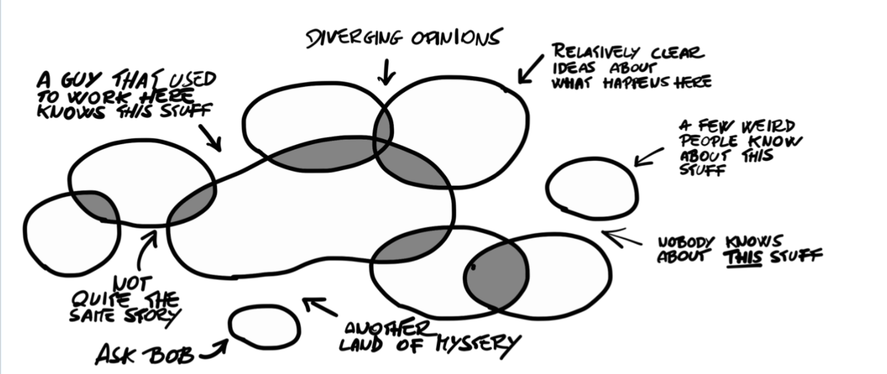
(2)The plural of anecdote is data
Notes:
No matter what the statisticians tell us, the plural of anecdote is data
This is a picture taken from the book Event Storming by Alberto Brandolini
We’re sure many of you will recognise the bits of an organisation that only Pauline in accounts knows about
Any complex environment relies more on narrative than “rules”
People share stories and stories shape the environment
Dave Snowden - of Cynefin fame - has some excellent observations on the value of stories in work places

Slide 40
(3)Make friends with contradiction and contrarians
Notes:
It’s often helpful to invite more than one domain expert to any session
It’s even more helpful if they’re at different levels of seniority
But not so far separated they’re afraid to disagree
Some of our best sessions start with disagreement

Slide 41
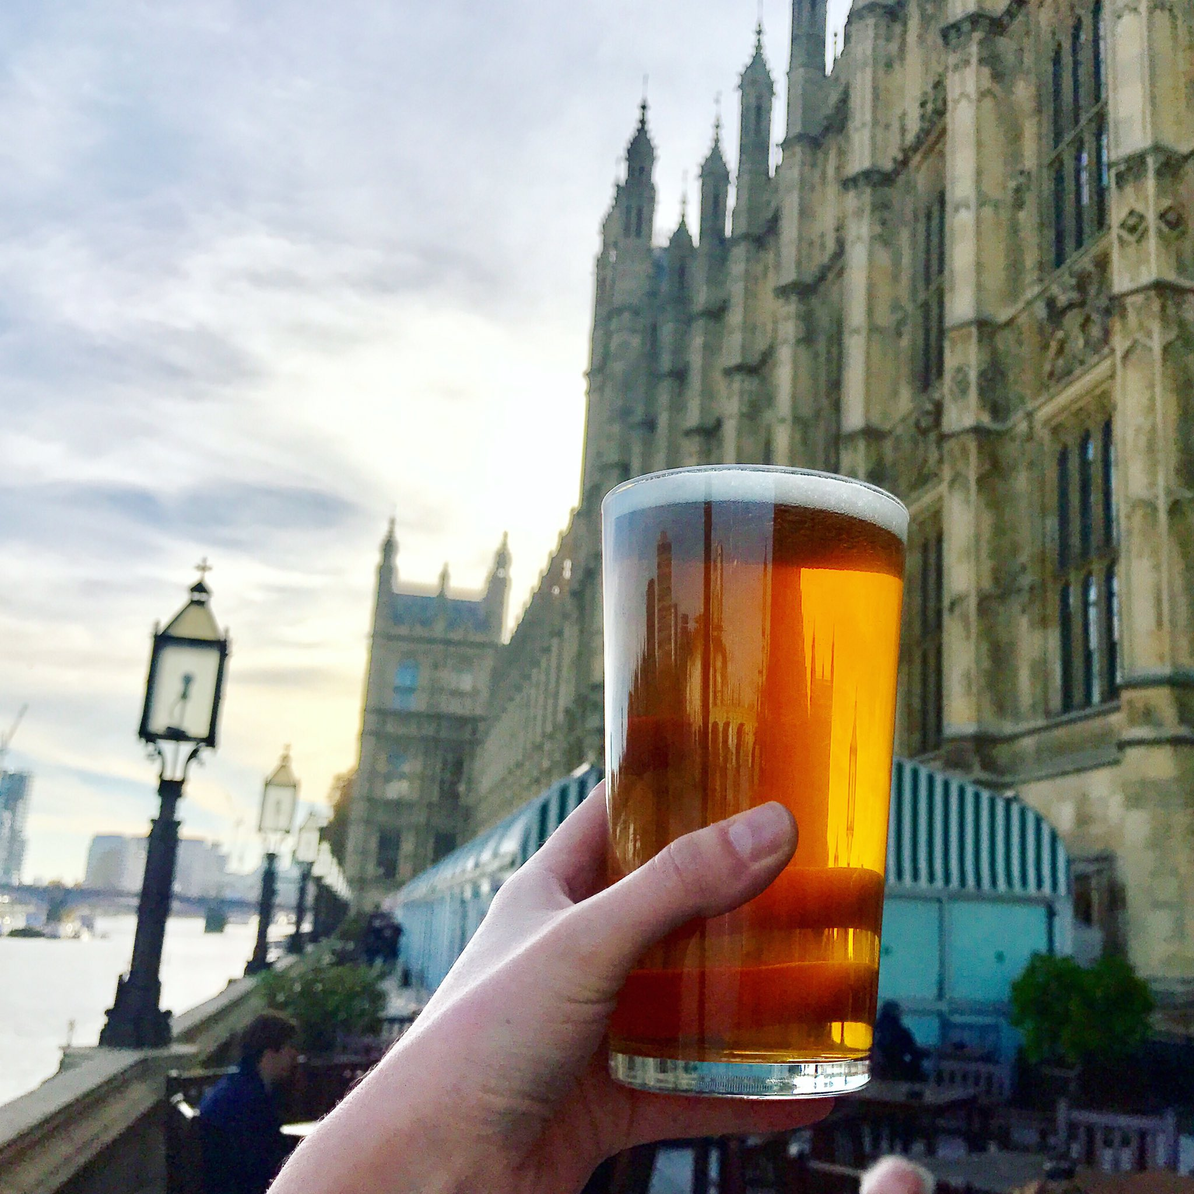
(4)Use graphs to subvert hierarchies
Notes:
How organisations think they work and how they work are two different things
Think of all those cascaded emails you already knew the contents of
Find out how networks work in your organisation
Bear in mind organisations are porous
Twitter can be your friend

Slide 42
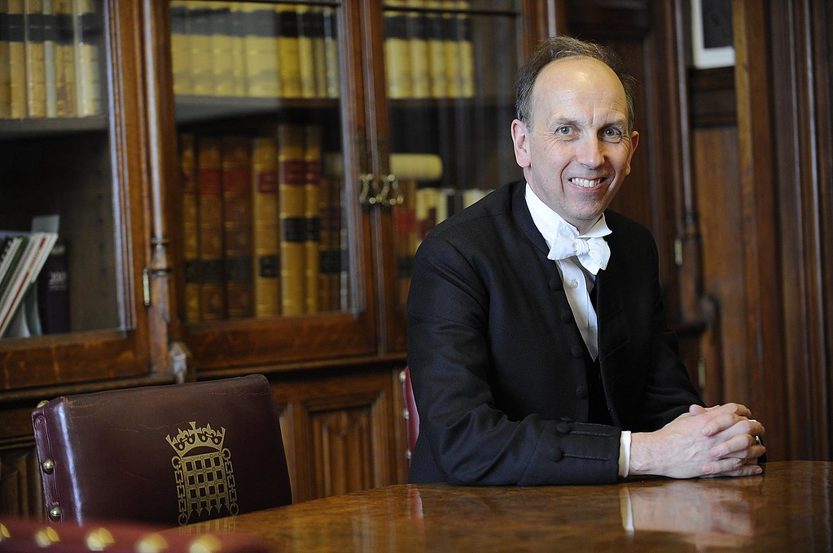
(5)Retirees have the best stories
Notes:
And lastly, if you want stories the people with the best ones are often retired
We work with a number of retired clerks all of whom have many great stories to tell

Slide 43
Domain modelling for the four trick pony
Don’t conflate identity with naming
Would you describe this as a thing with agency?
Would you describe that as a work or an expression?
How many of those things can that thing have?
Notes:
And some more tips around the kinds of things you may want to question
Try not to conflate identity with the naming or labelling of things. We have a recurrent problem with parliamentary sessions being identified by their start and end dates. The latter being subject to change
Think about whether the thing you’re modelling has agency. Can it effect changes in the world
Functional Requirements for Bibliographic Records – or FRBR – is a handy reference point for things far beyond document management
And questions around cardinality are key. How many of those things can that thing have is always worth asking

Slide 44
90% of data debt results from incorrect cardinality
Notes:
Warning: this slide has no scientific basis
But based on experience, many an information project foundered on the rocks of cardinality

Slide 45
Back to SIs Flowcharts
Notes:
So then, back to SIs

Slide 46
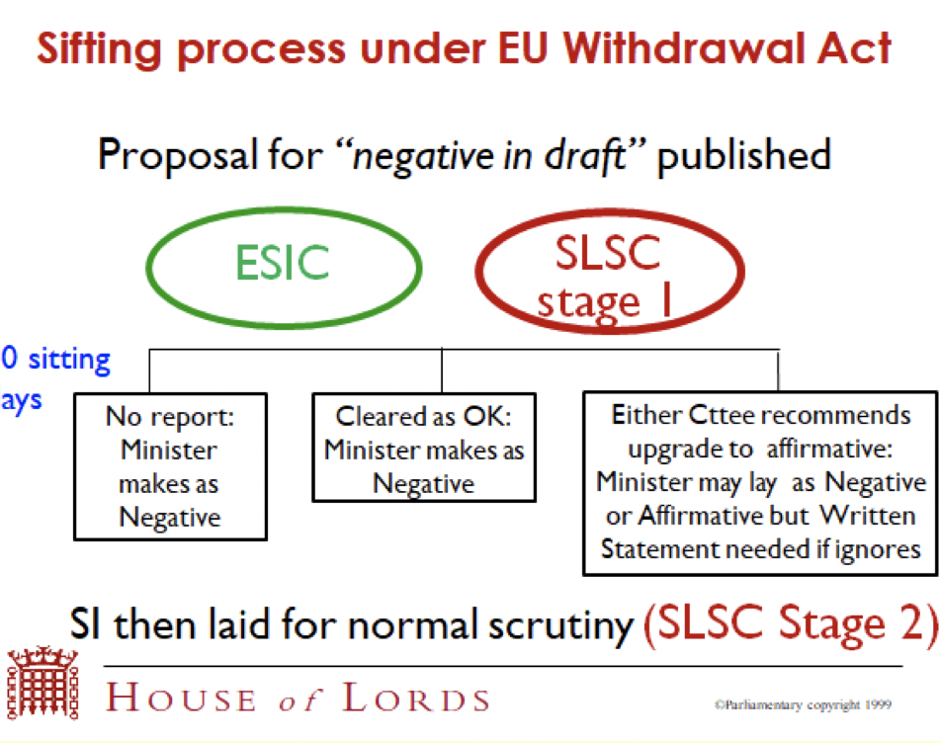
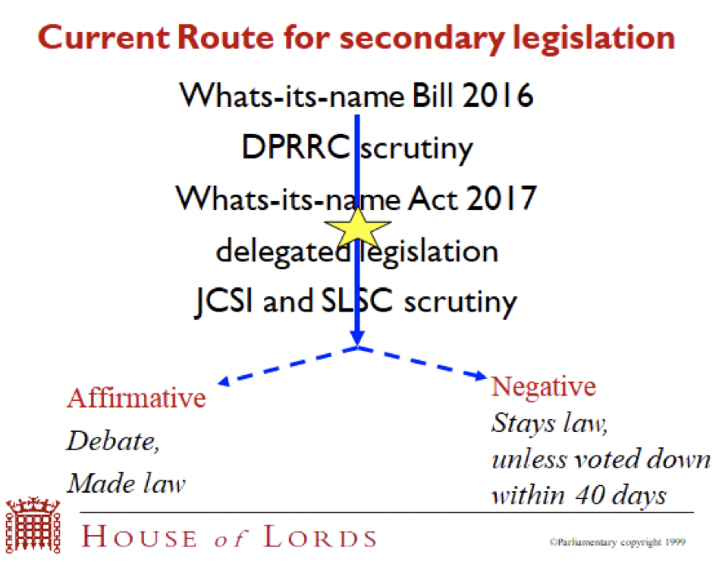
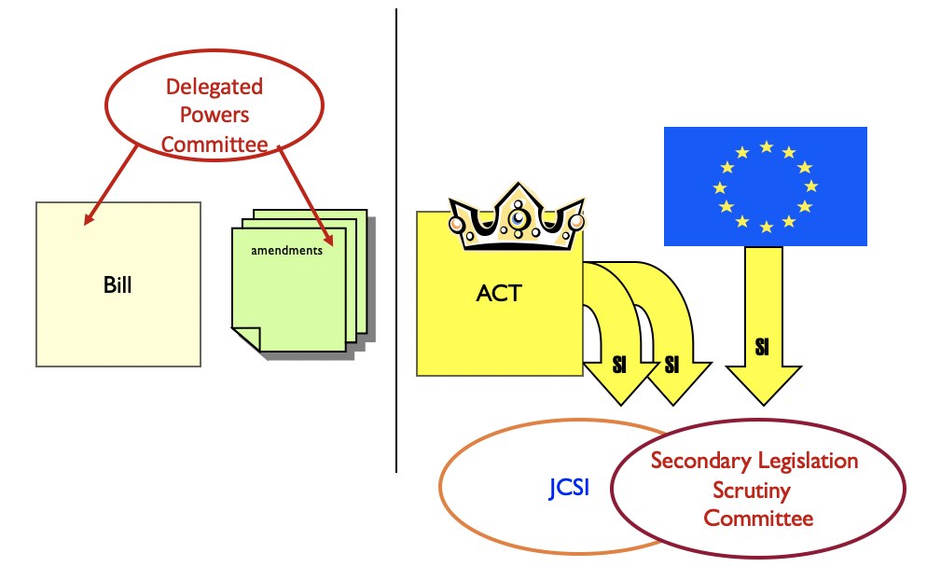
Endless flowcharts
Notes:
When we first started on the SI service, everyone we met brought us a flowchart
All drawn from a certain perspective and none complete
Over several months we talked and sketched and brought together multiple perspectives

Slide 47
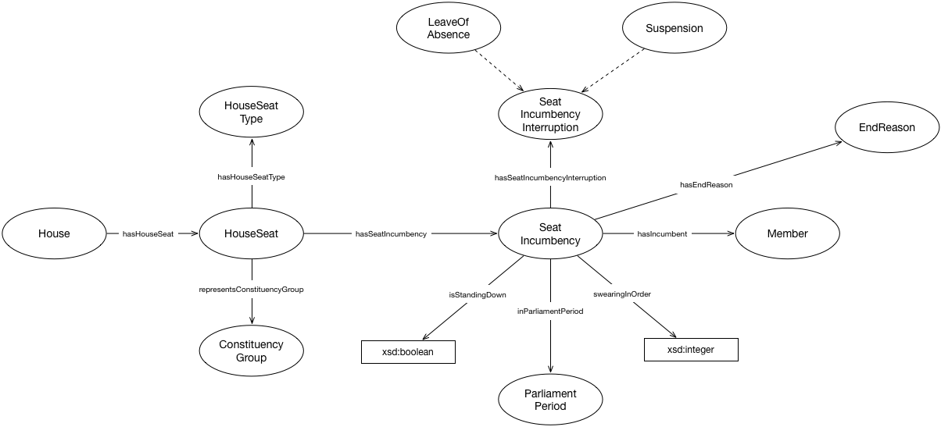
The procedure model
Notes:
The result was a process model implemented as an RDF ontology
Or a procedure model – procedure being Parliament’s word for process
It allows us to state that, given what has happened, what may, must and can’t happen next
A clerk would not recognise this model
It is generic, having no domain knowledge or domain language encoded

Slide 48
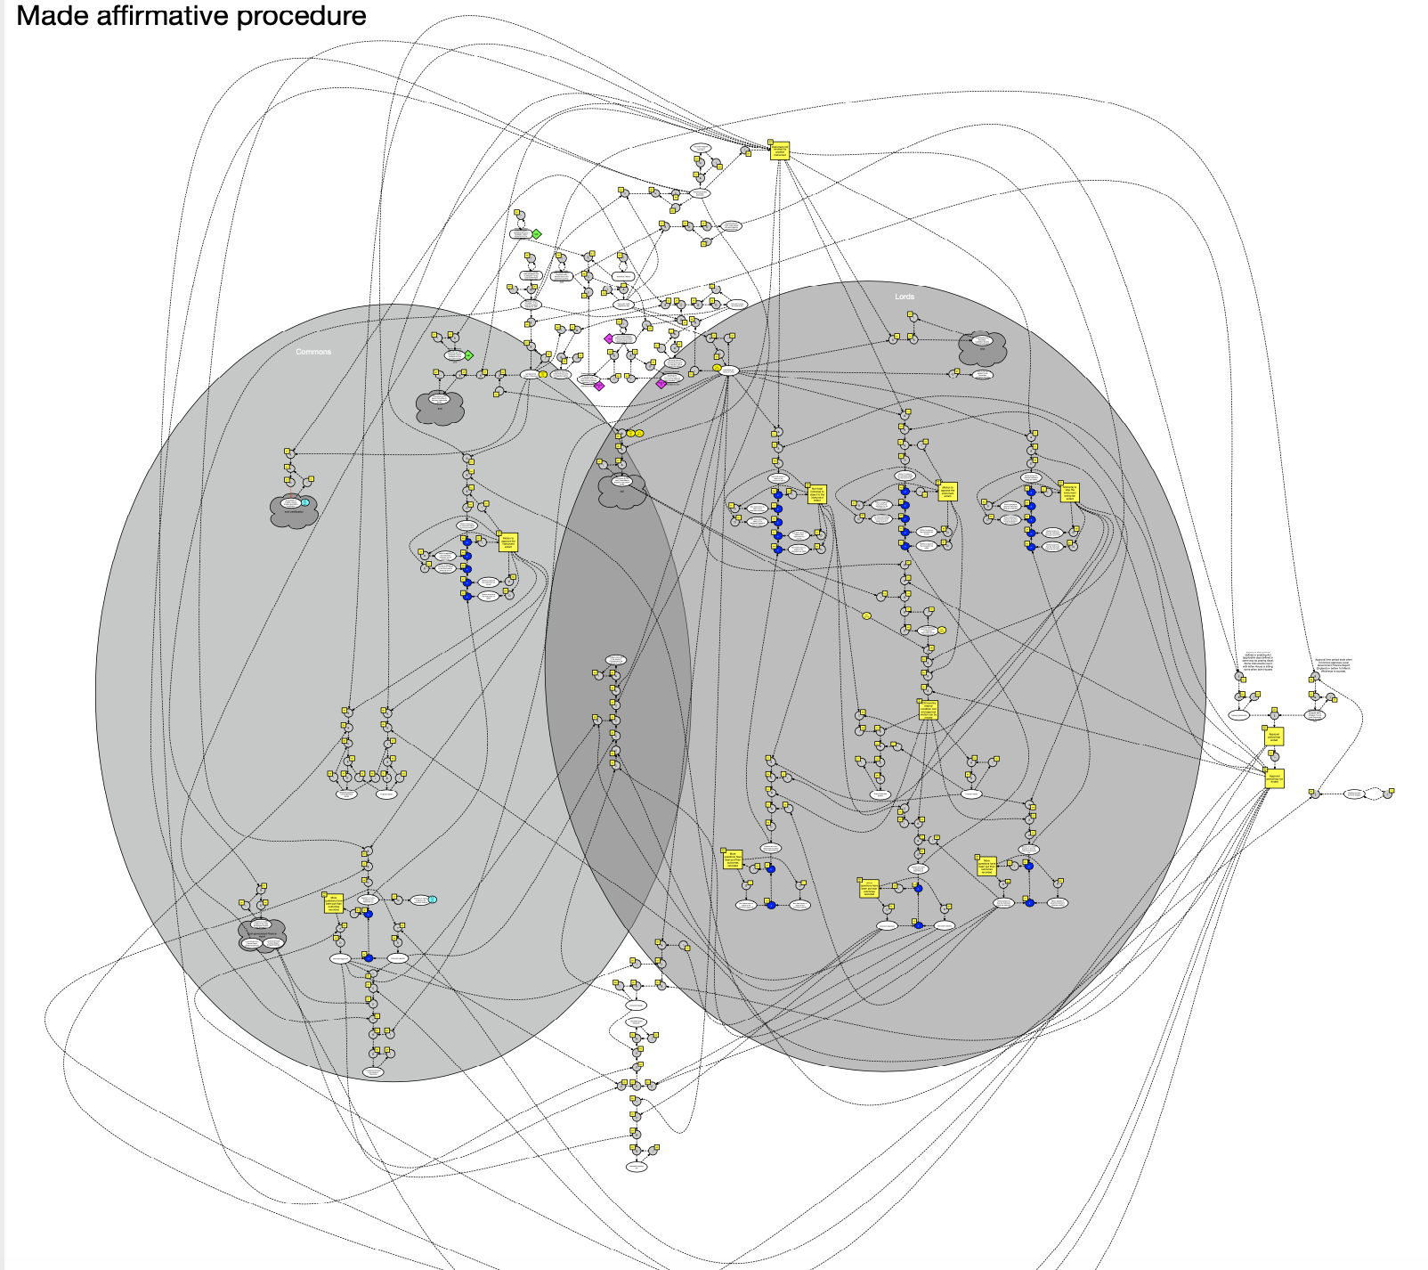
The maps
Notes:
Whilst the model may be generic, layered on top are procedural maps
Most of our time is spent mapping procedures on top of the model
This is an example of a procedure map for made affirmative statutory instruments

Slide 49
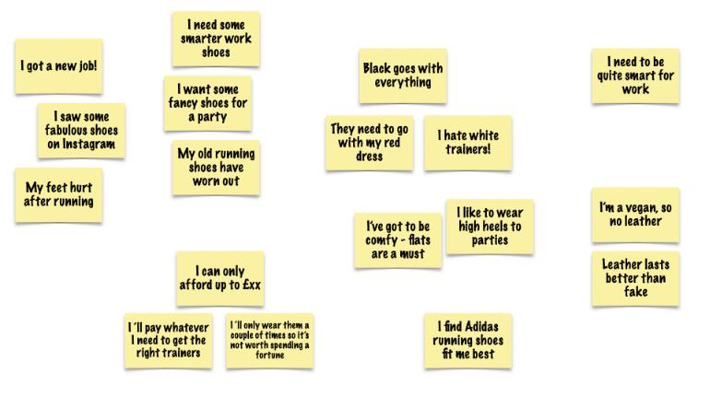
The cult of user needs
Notes:
You may have noticed that we’ve not talked about what users might need from an SI tracking service
We find that an emphasis on user needs isn’t always helpful
By concentrating on describing the domain we don’t lock ourselves into single solutions
Not only do needs differ across user groups, sometimes our users have needs that are diametrically opposed to the needs of other users
This being the nature of politics

Slide 50
What we’ve made
Notes:
So after all this talking and sketching and listening to lots of stories
What have we made?

Slide 51
Notes:
This is the statutory instrument website that Parliament asked for
A website that can flex and adapt as Parliament flexes and adapts
In collaboration with the Journal Offices and committees we’re making changes to procedure maps on an almost weekly basis
Not because we did it wrong but because procedure evolves

Slide 52
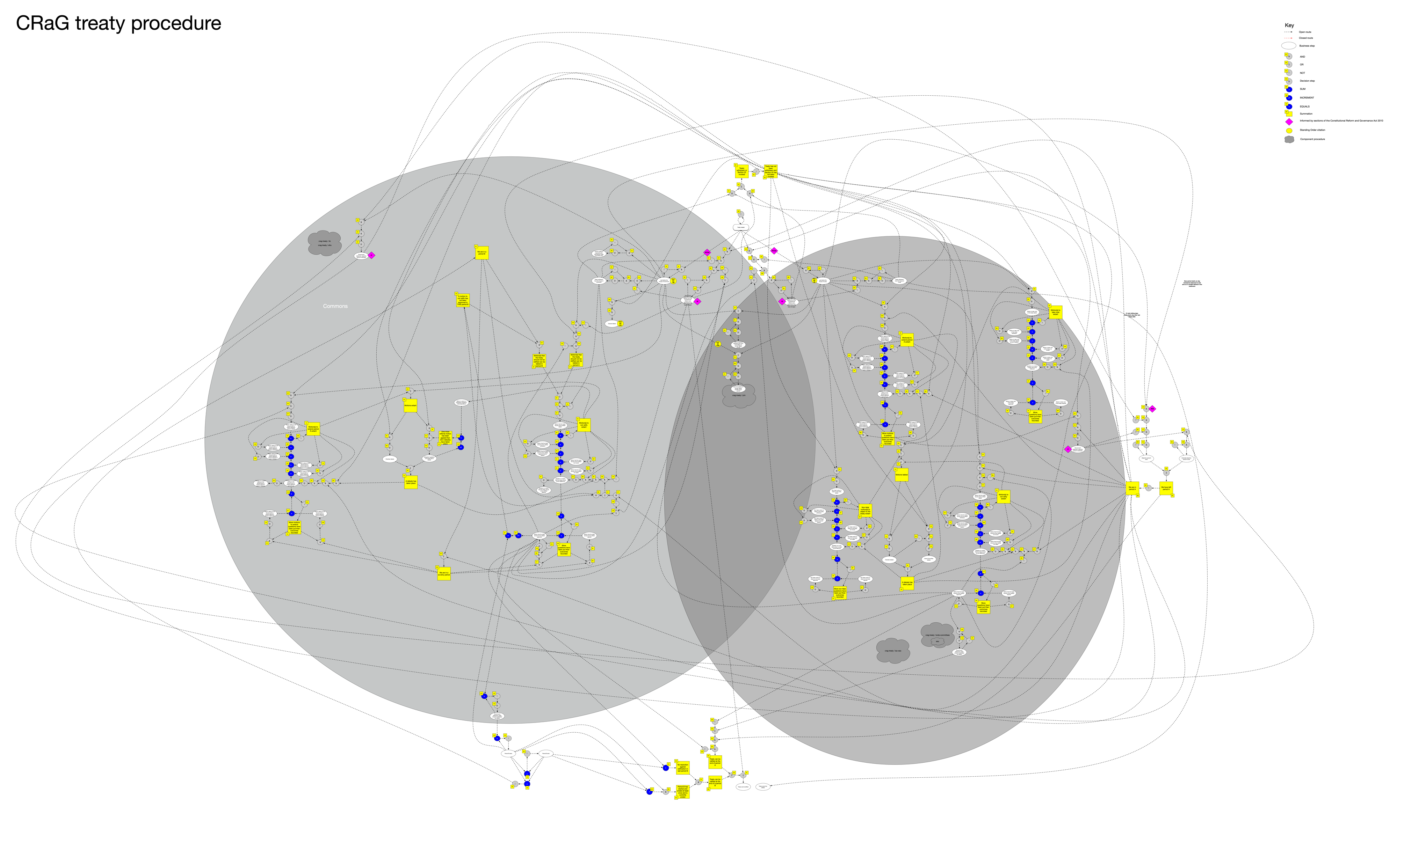
Treaty procedure
Notes:
By understanding the domain, choosing the right bounded contexts we can do more
Because we now have a generic model for procedure we can – with relative ease – map new procedures over the top
Post brexit, treaties have obviously become rather important so in 2019 we were asked to build a tracking service for treaties
This is a map of the treaty procedure as set out by the Constitutional Reform and Governance Act 2010
With additional bells and whistles as set out in standing orders and in precedence
Because no one ruleset is ever complete

Slide 53
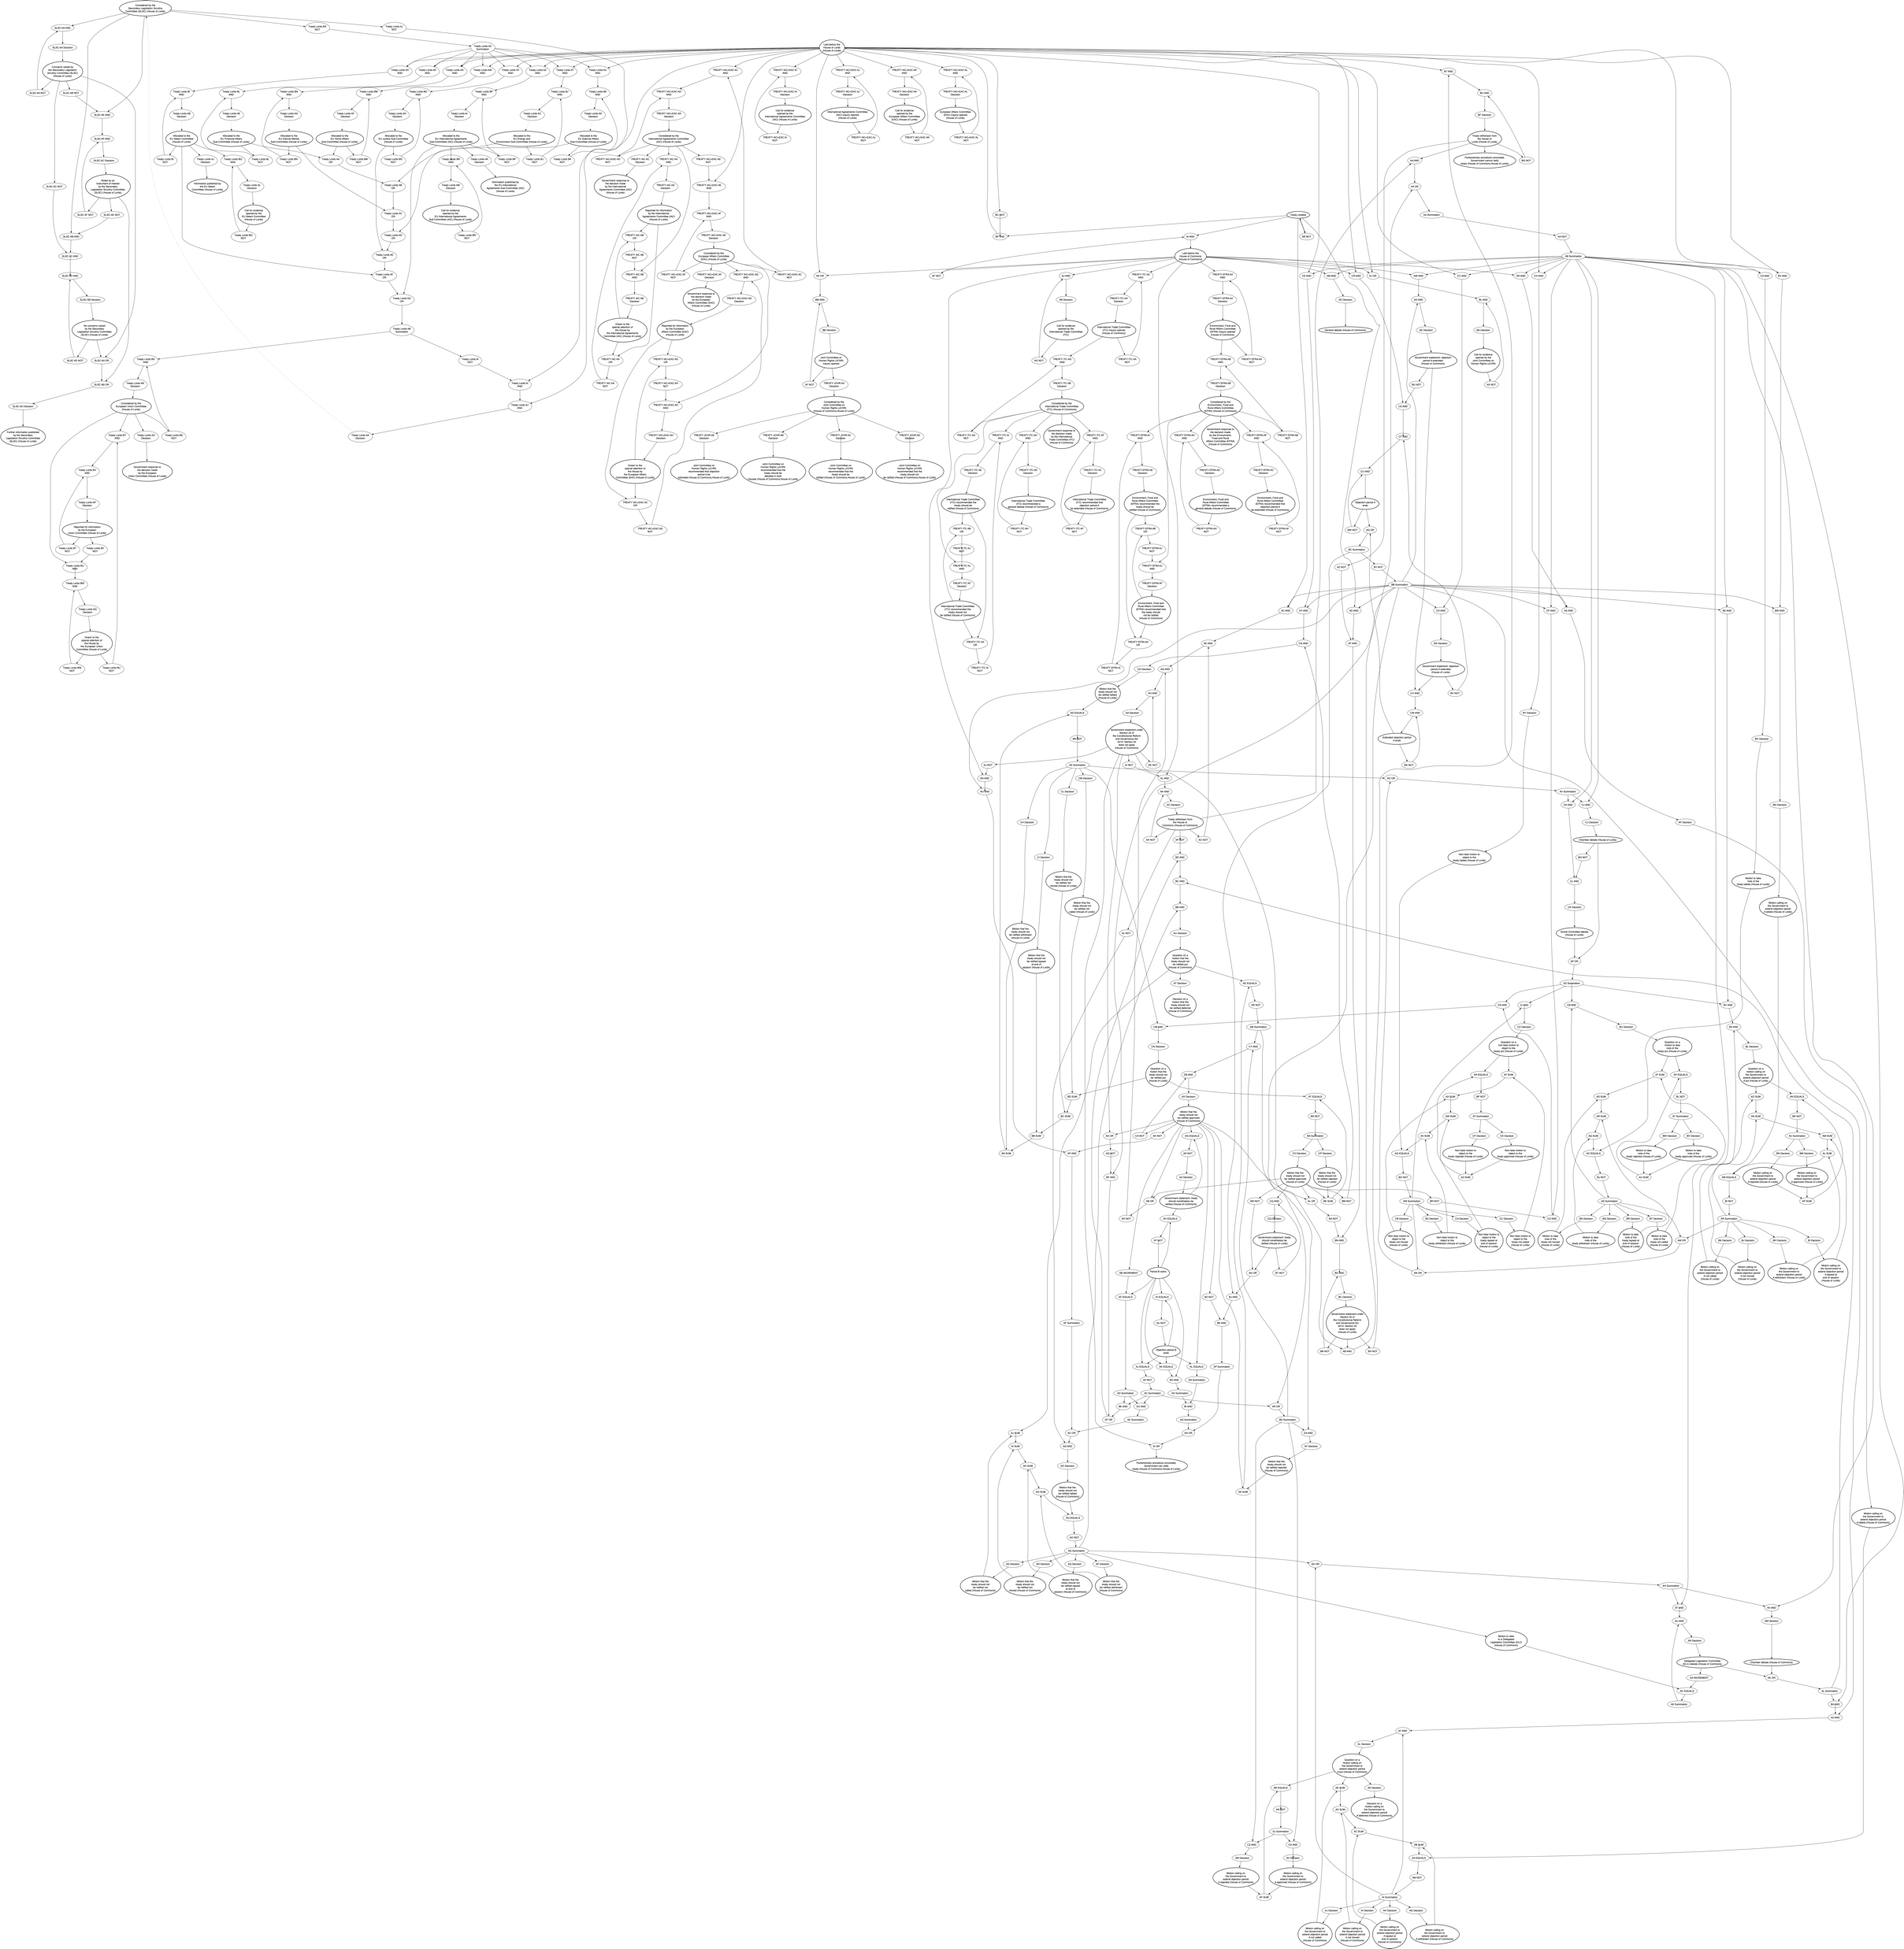
Treaty procedure
Notes:
And this is that same map, as drawn by a machine

Slide 54
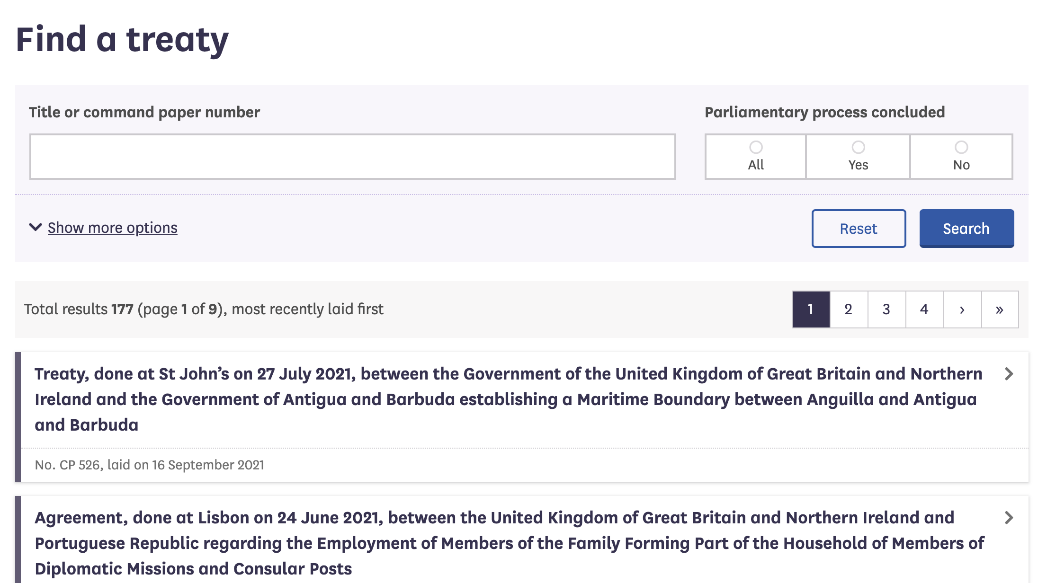


Notes:
And with almost no work we made a website and a library of queries for treaty procedure too

Slide 55
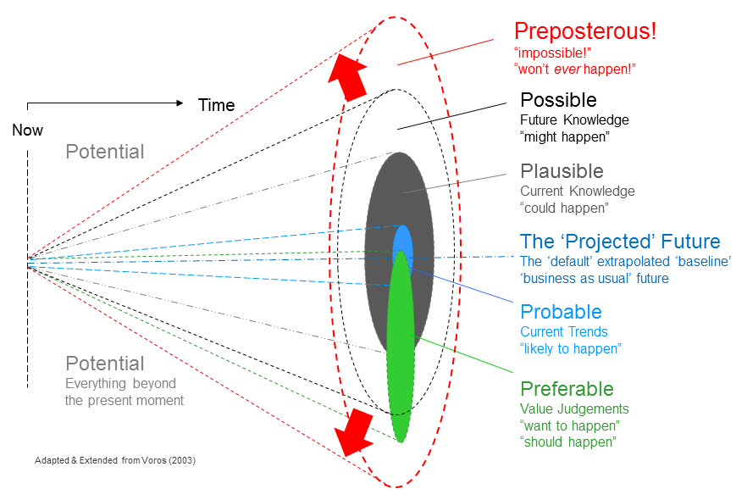
Procedural light cone
Notes:
We’ve already mentioned that the maps can be parsed by machines to determine - from what has happened - what may, must and shouldn’t happen next
We call this the light cone of procedural possibilities
We can use this data to alert Members to points at which they can intervene, for example: from this point on and for the next 40 days you can table an objection to this SI

Slide 56
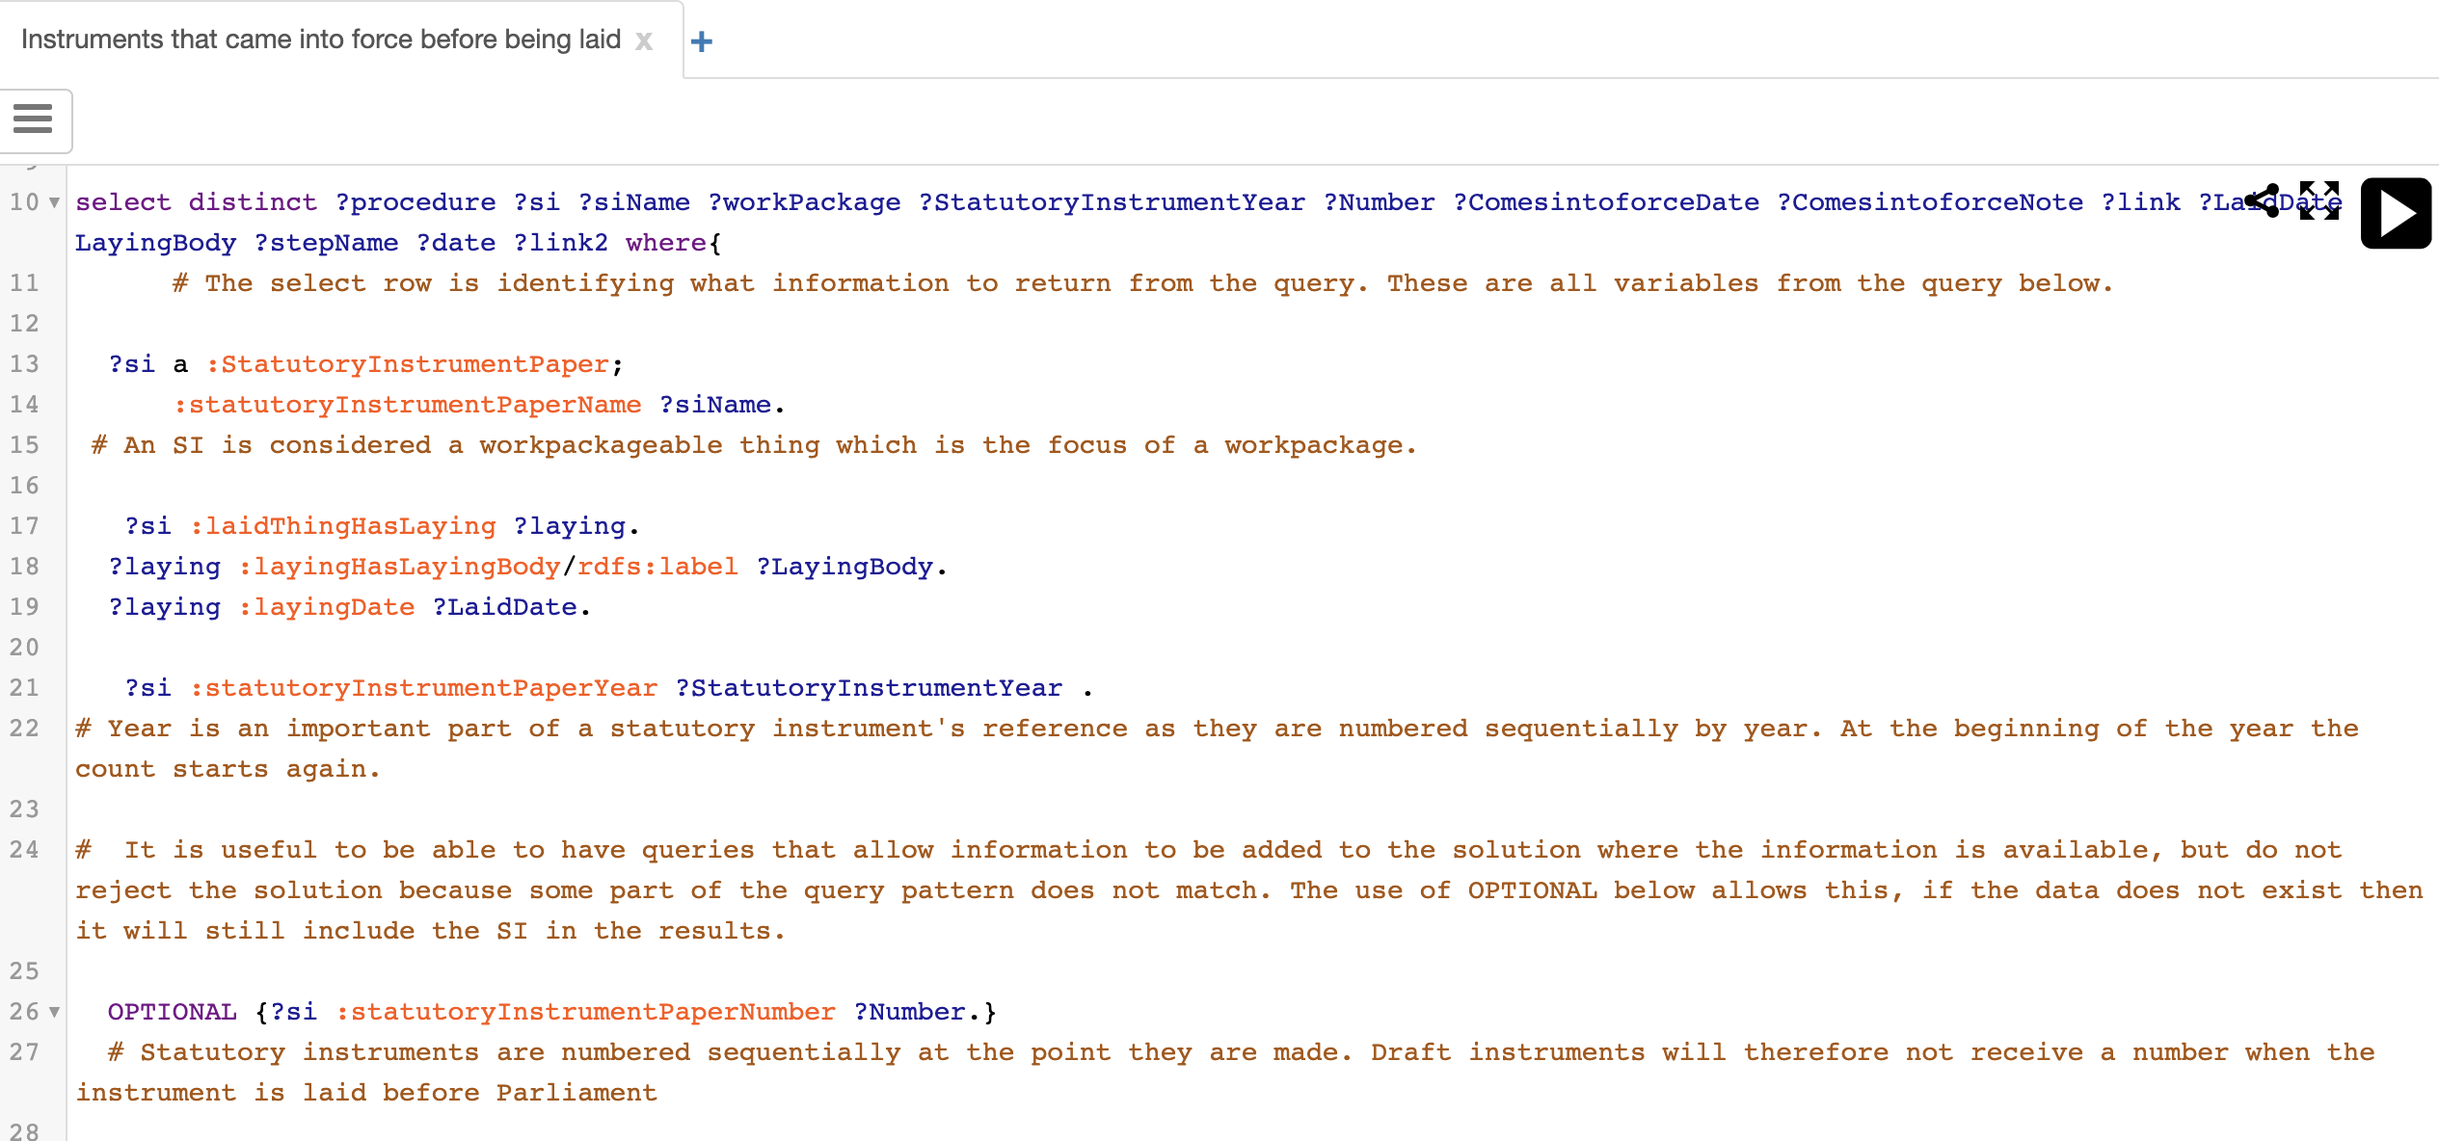
Precedence as a query
Notes:
And we have a pot of data we can query for precedence
Queries such as: when did X and Y both happen when Z didn’t

Slide 57
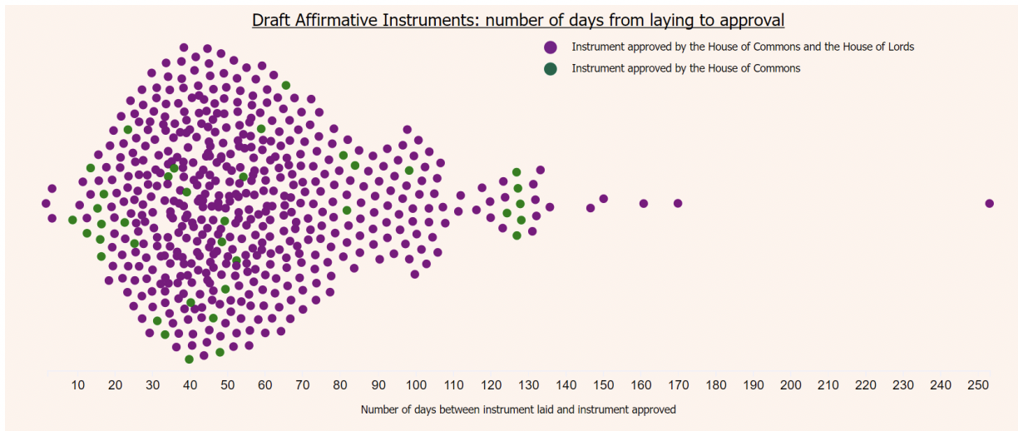
The fish of affirmation
Notes:
We can use the pot of data to look for patterns
This is one example showing the number of days between laying and approval of draft affirmative instruments
More importantly, the queries are repeatable

Slide 58
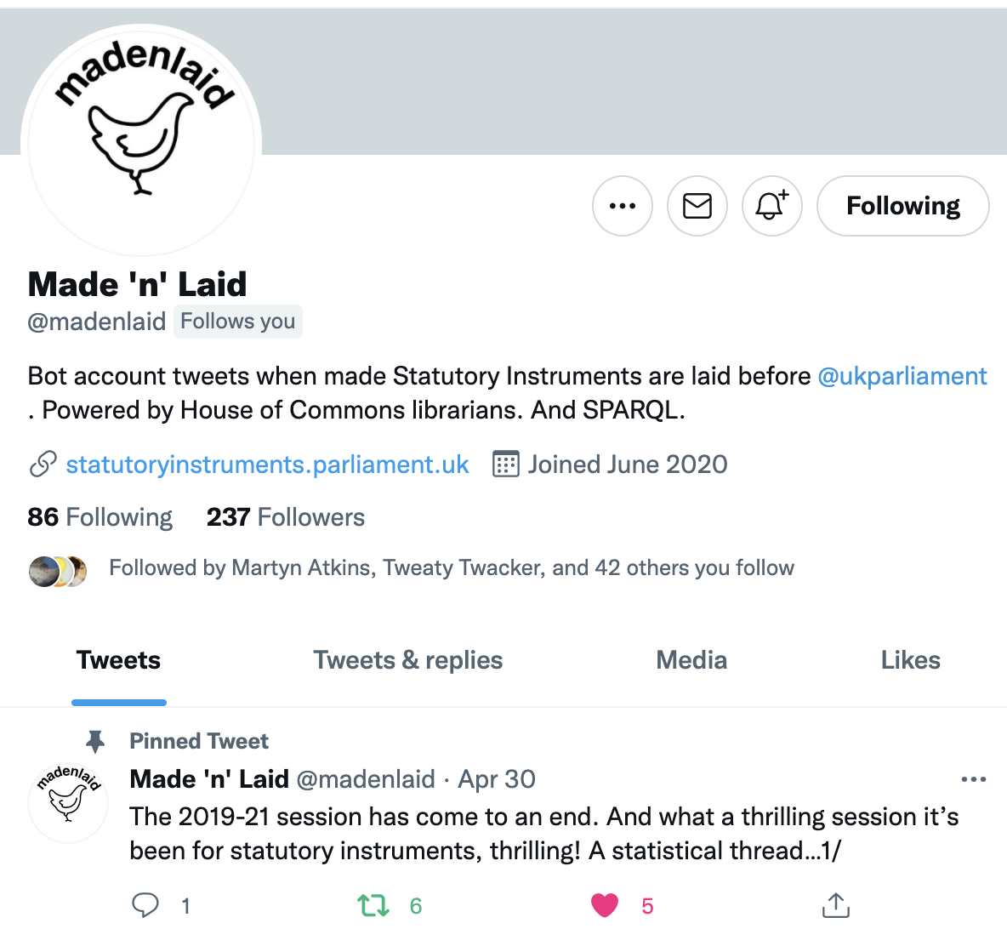
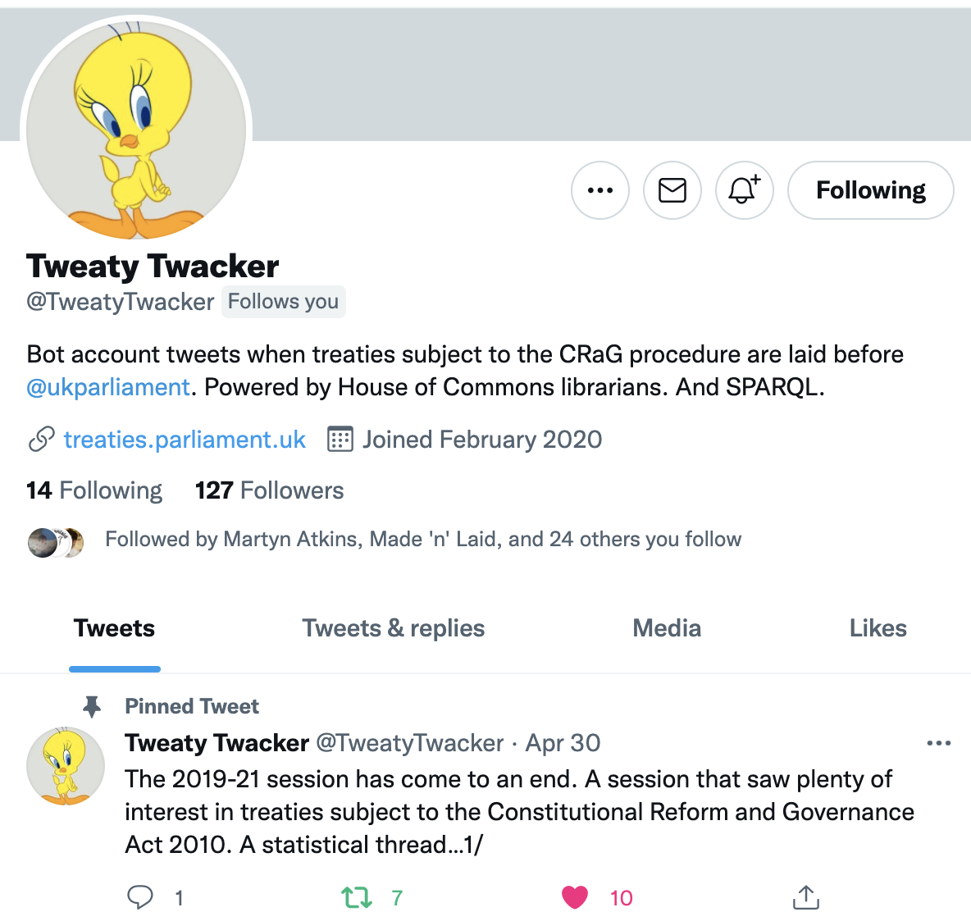
Emergent possibilities
Notes:
Strangely enough, nobody asked for Twitter bots for SIs and treaties but a couple of hours work and we now have 239 people following avidly

Slide 59
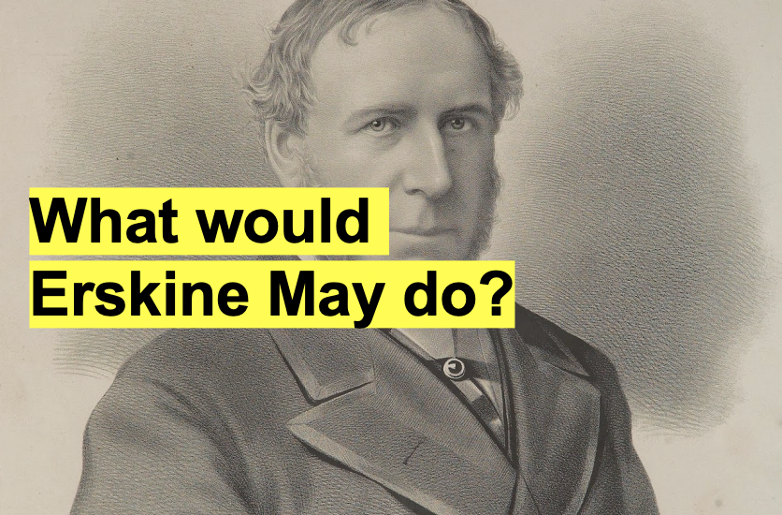
Notes:
In summary
Information management is hard work
Understanding the domain is not quick
But well modelled, well managed information is generative
Possibilities emerge when you take the time and trouble to understand the domain
We often ask ourselves – if Erskine May had had a computer – what would he have done
We think possibly…
He would have used it to build a graph of knowledge of parliamentary business
And built a precedence engine out of data
Thank you

Slide 60
Afterword
Notes:
And just when you thought you were rid of us
And could go and have your tea

Slide 61
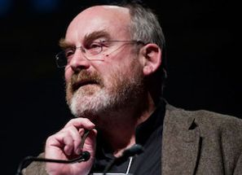
Retrospective coherence
Notes:
We’re back with Dave Snowden
He talks about retrospective coherence
In other words, we tell ourselves stories to make what has happened seem like it was always inevitable
This talk and most other talks being great examples of that
In retrospect we can make it sound like we had a plan
That we always knew we were working toward machine readable parliamentary procedure
Reader – we did not know this
Like much else, we muddled through
And any narrative we may have attempted is only possible through the benefit of hindsight
You shouldn’t trust our story anymore than you’d trust any other
Thank you

